Slide 1
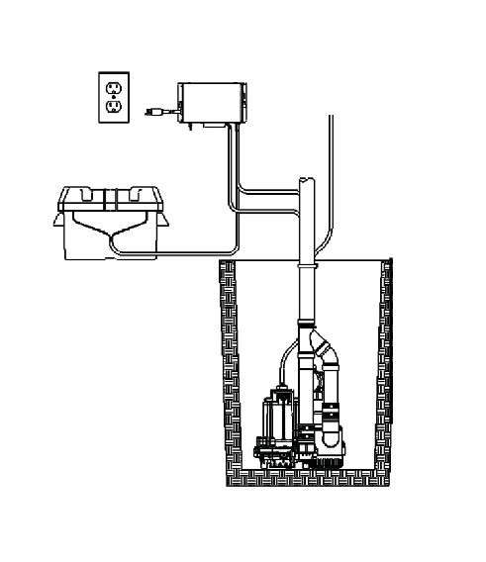
Quick Install Guide
JMI-POM
PEACE OF MIND

Slide 2
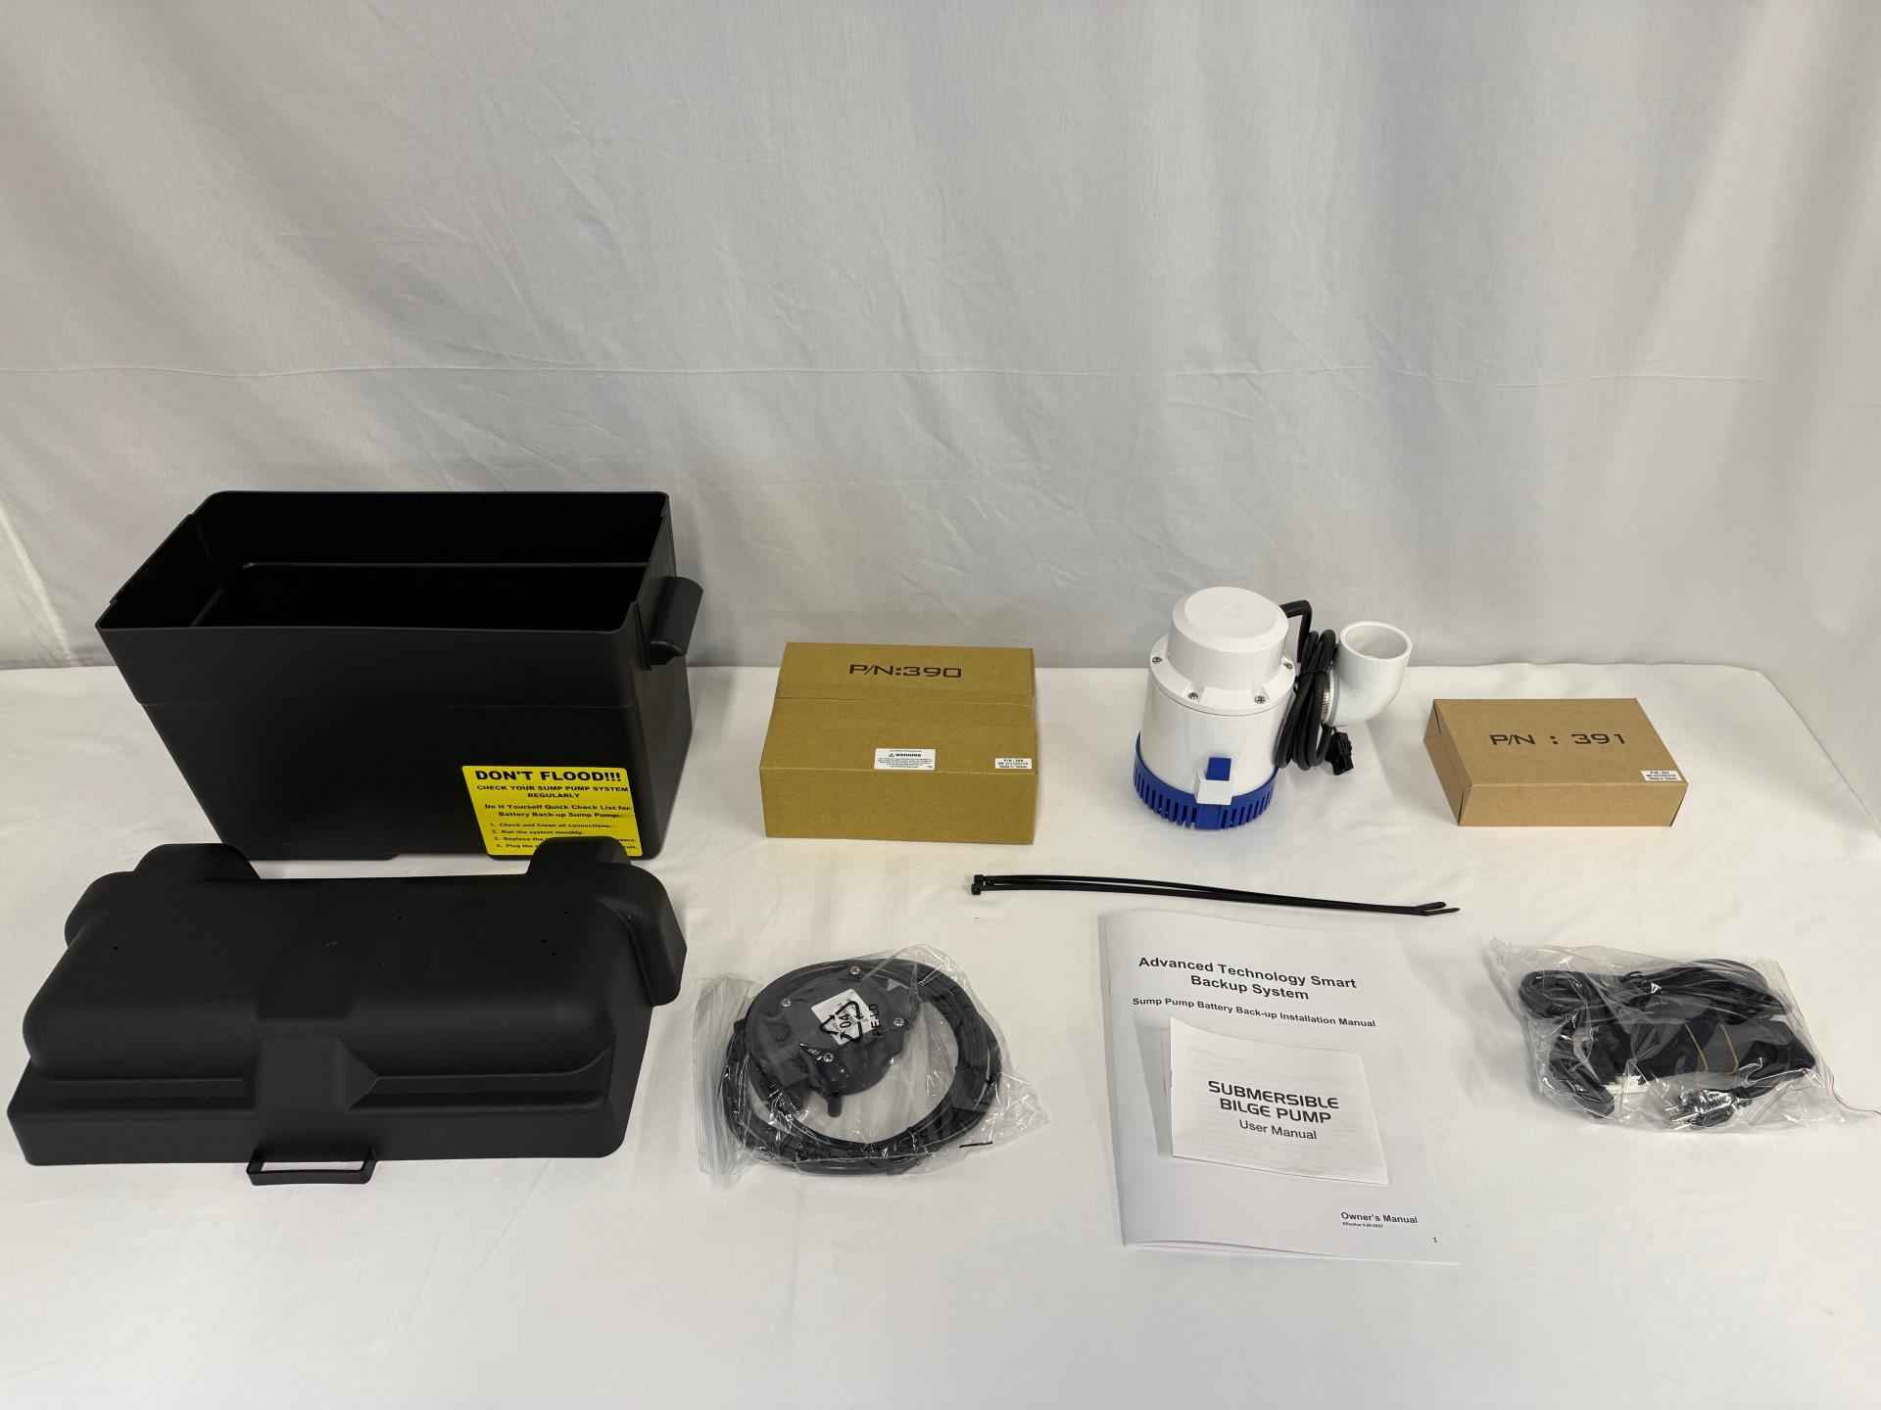
POM System components

Slide 3
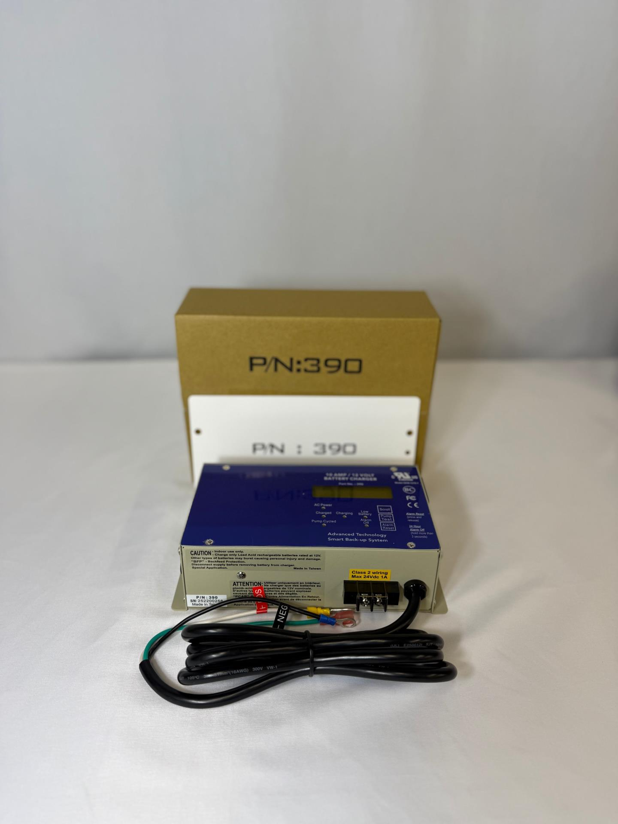
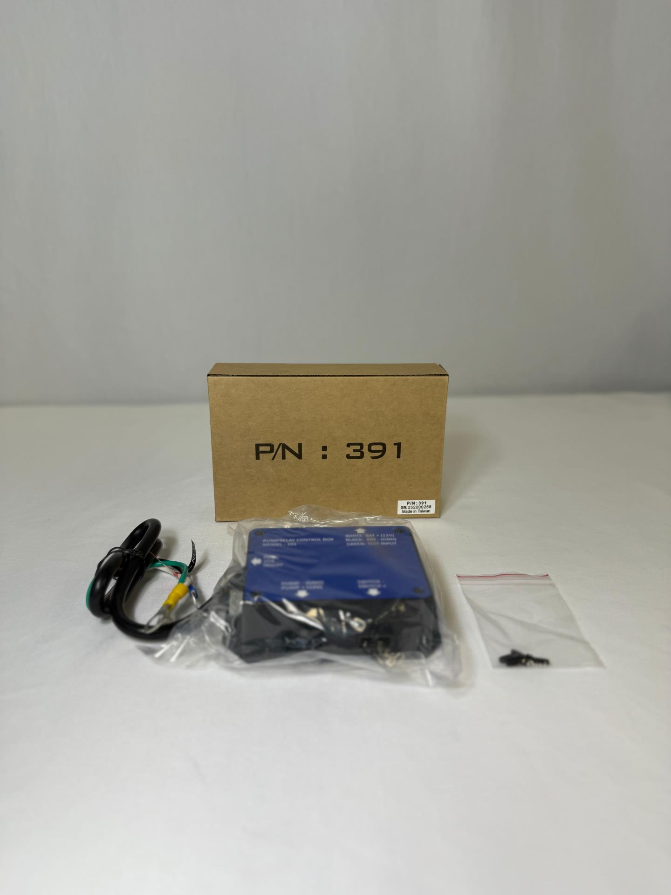
PN - 390 is CONTROL / CHARGER
PN - 391 is RELAY BOX

Slide 4
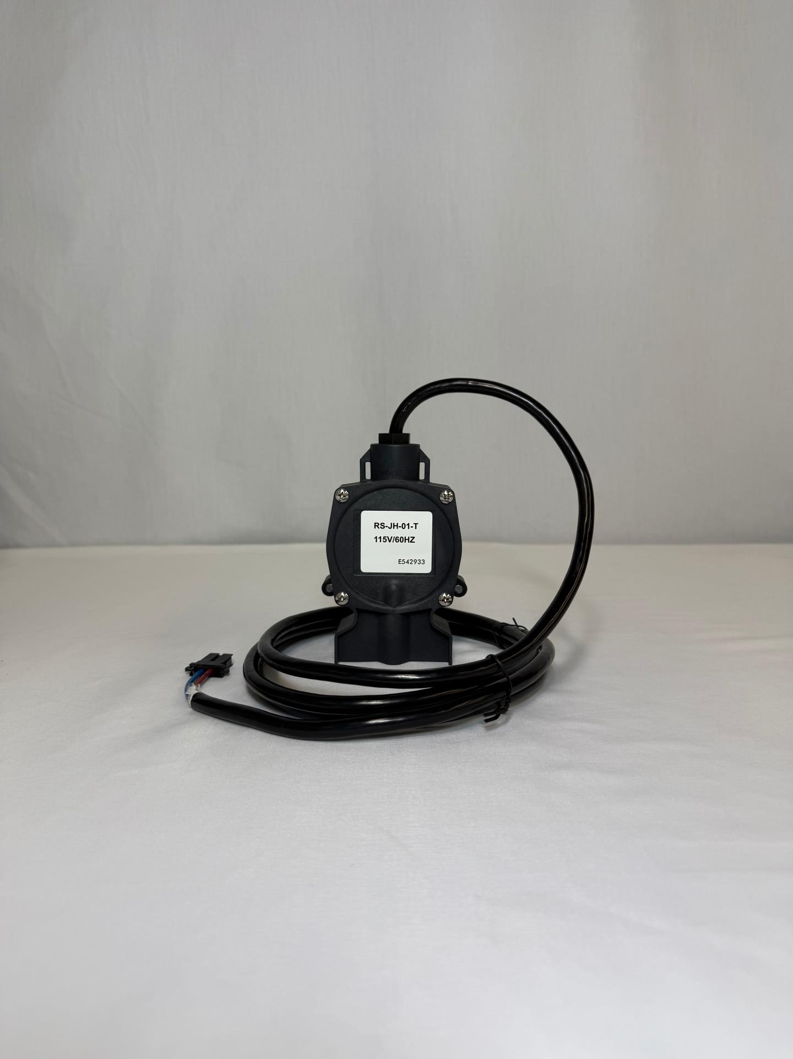
RS-JH-01-T is PRESSURE SWITCH

Slide 5
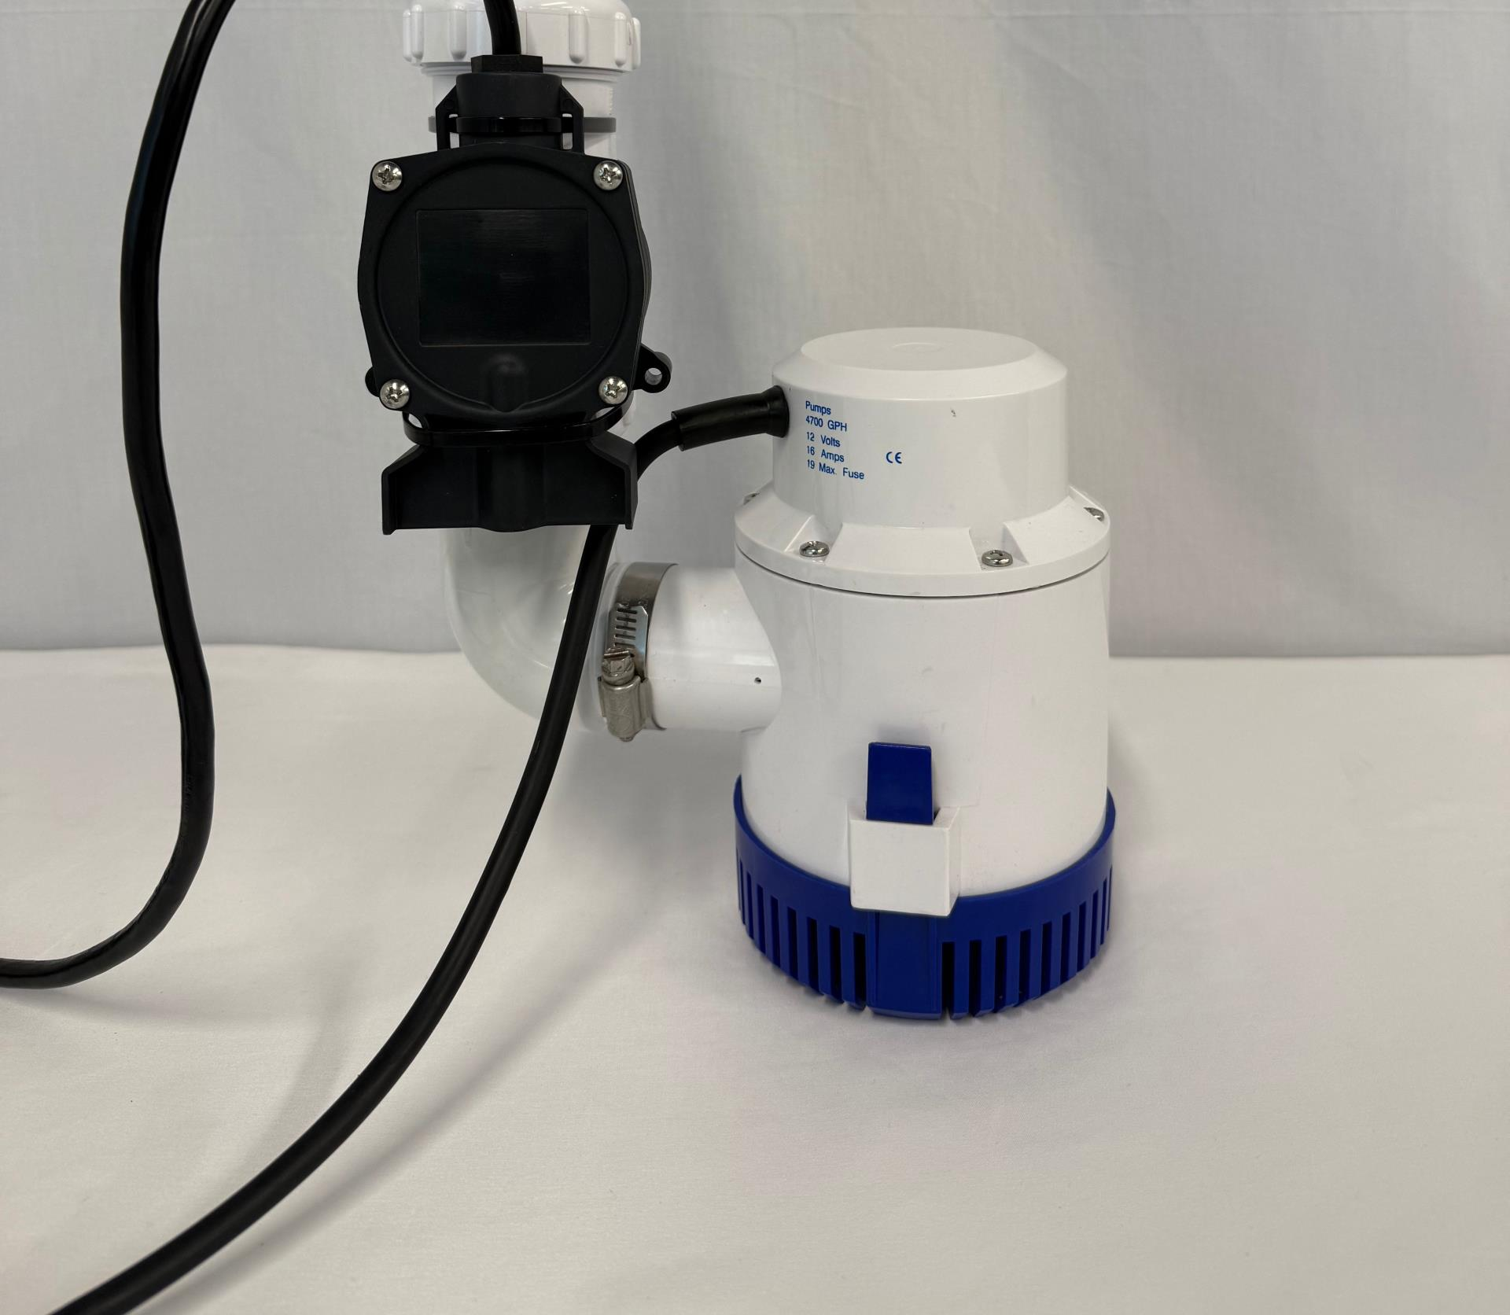
Supply Pipe and Check Valve. Assemble PRESSURE SWITCH & DC PUMP with ZIP TIES. DC Pump ON point should be ~2" above primary activation.

Slide 6
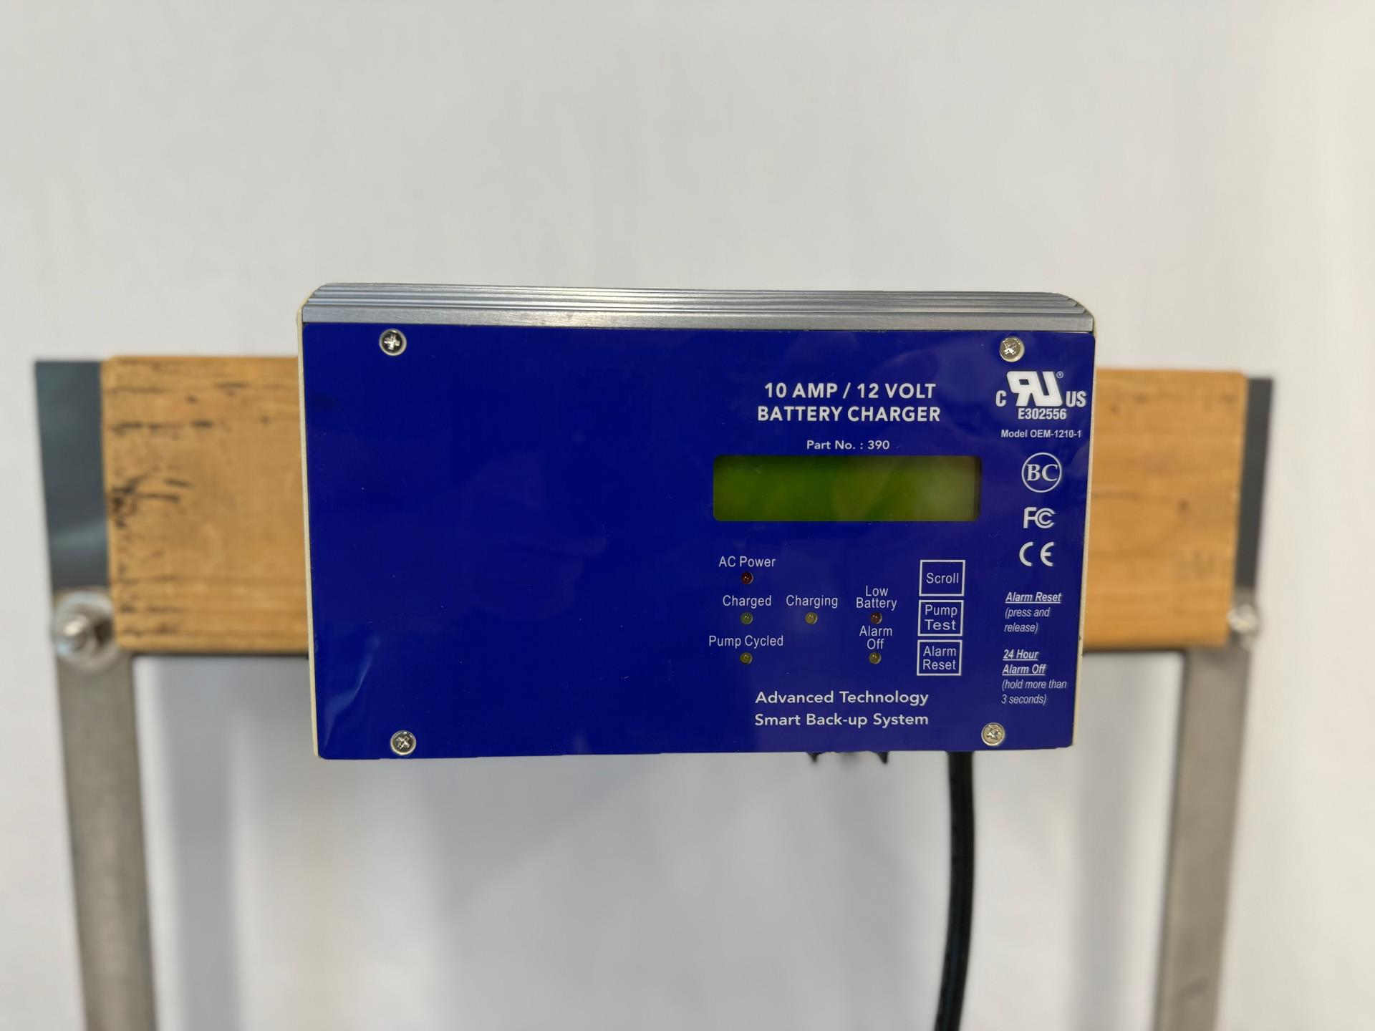
Mount CONTROL / CHARGER on wall or stud. Do not mount to battery box.

Slide 7
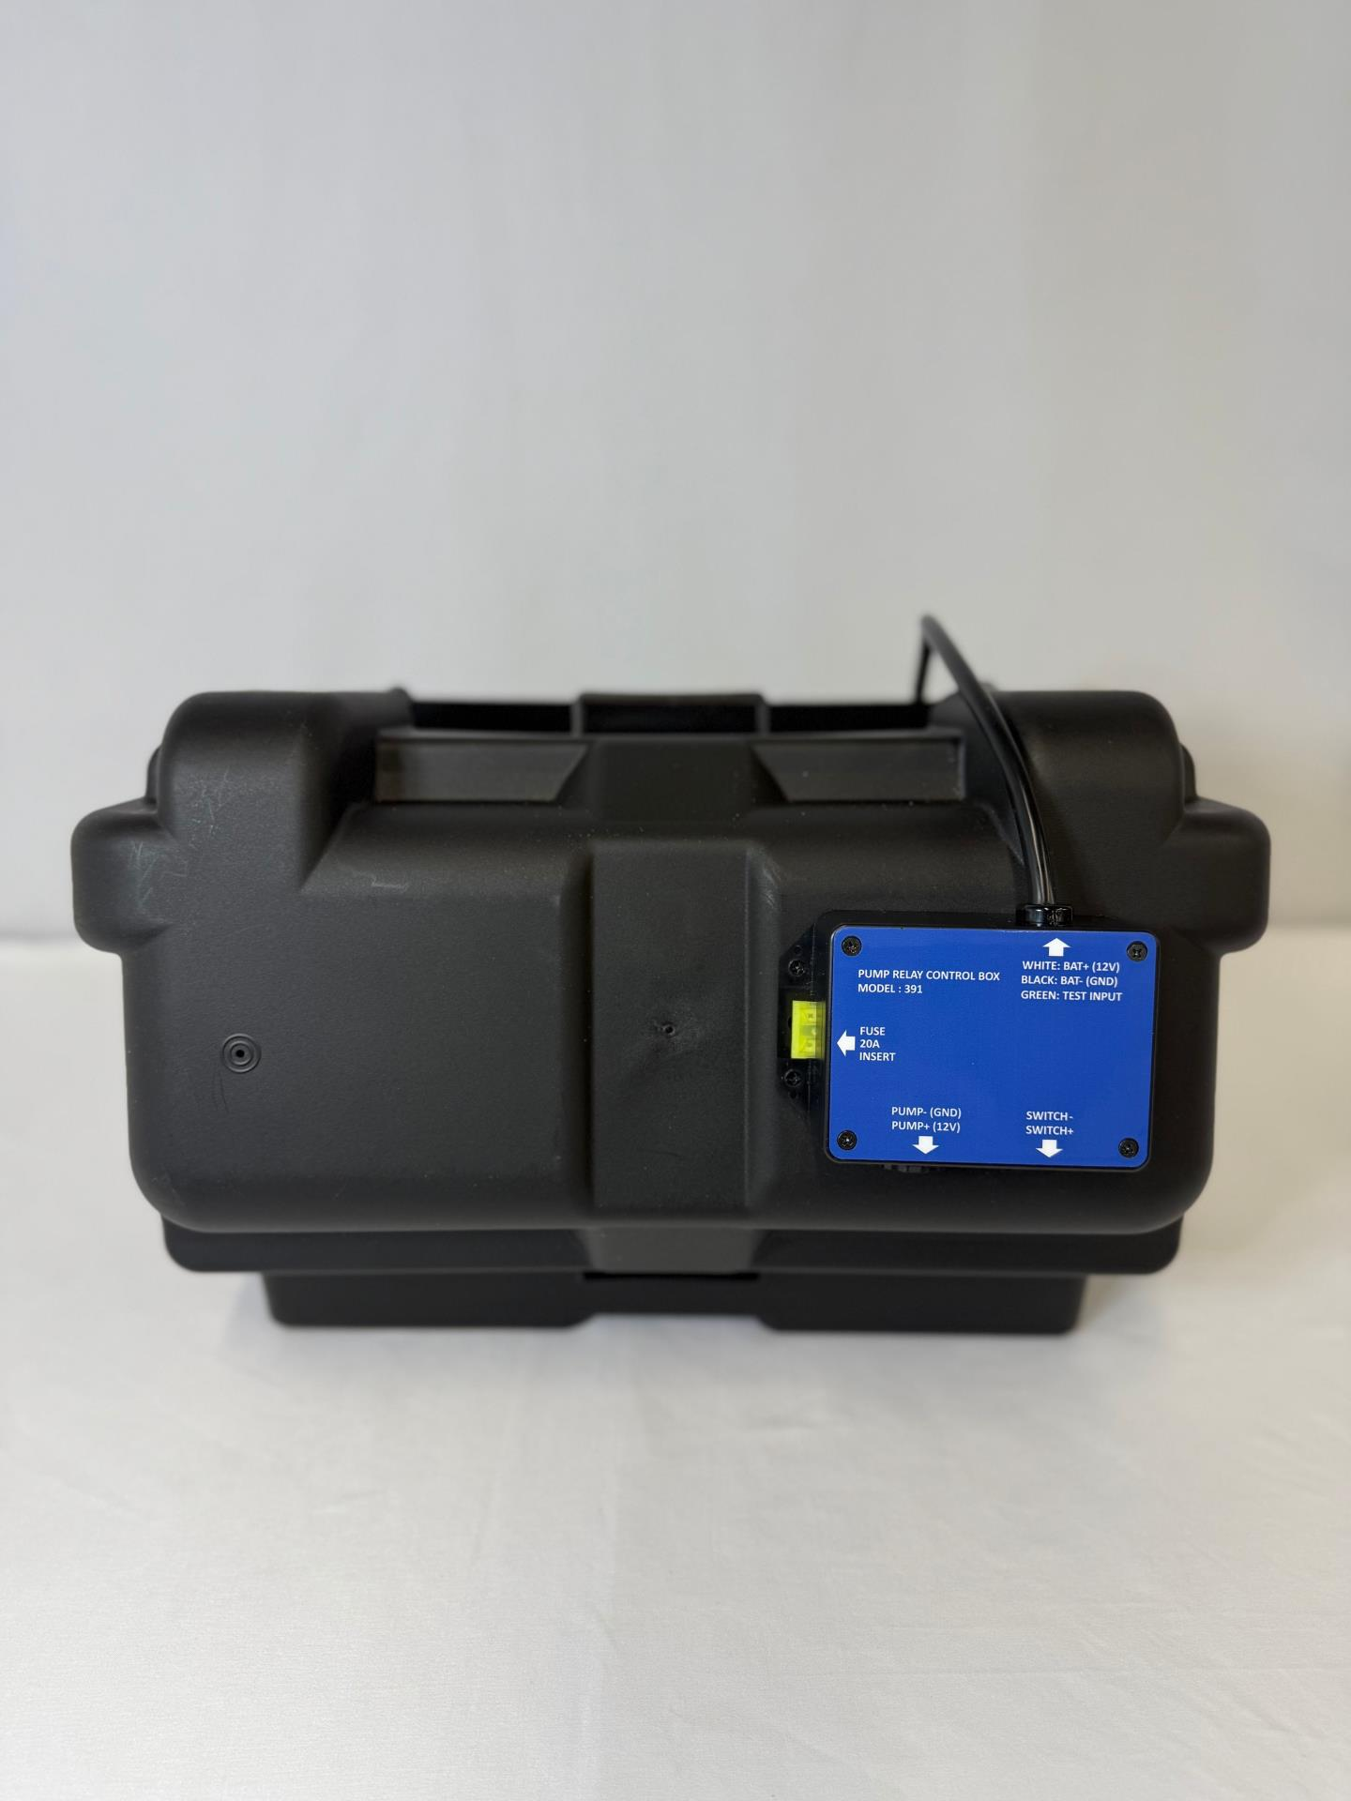
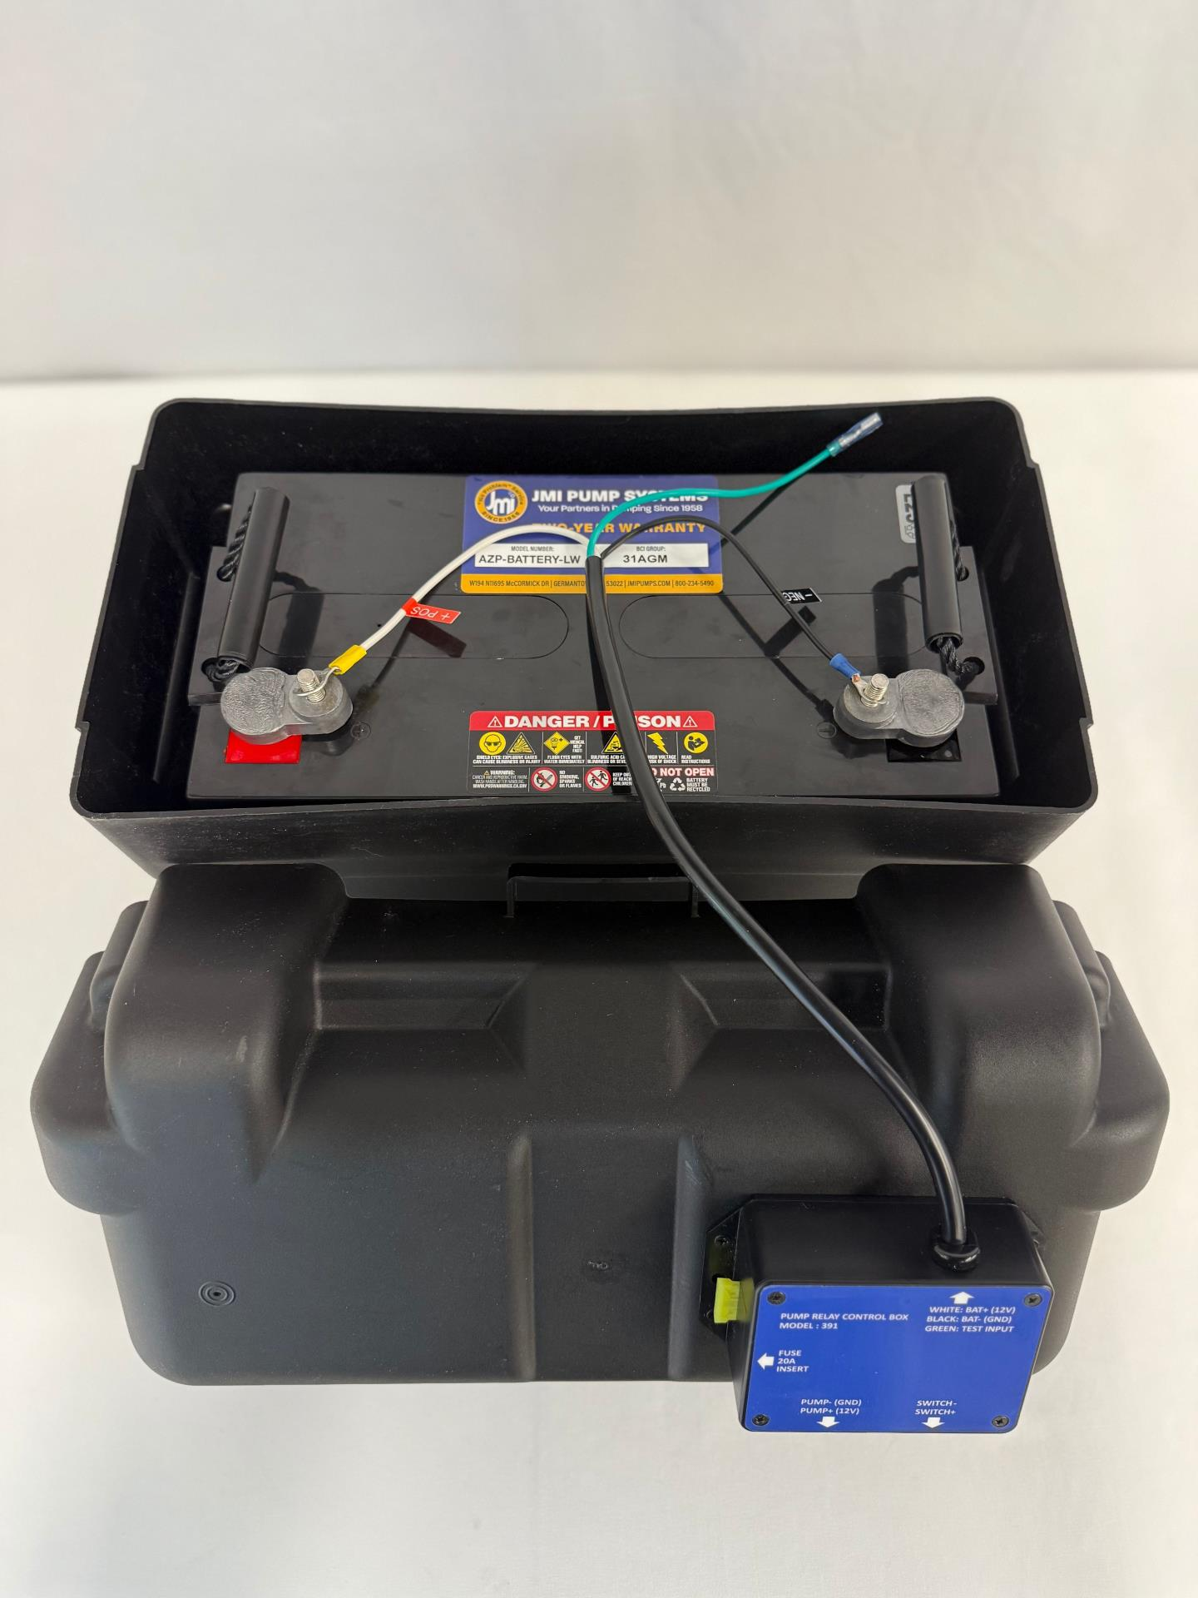
Using (4) black screws provided, mount RELAY BOX to BATTERY BOX via (4) pilot holes
Wire RELAY BOX harness to BATTERY-LW via terminals according to corresponding +/- labels

Slide 8
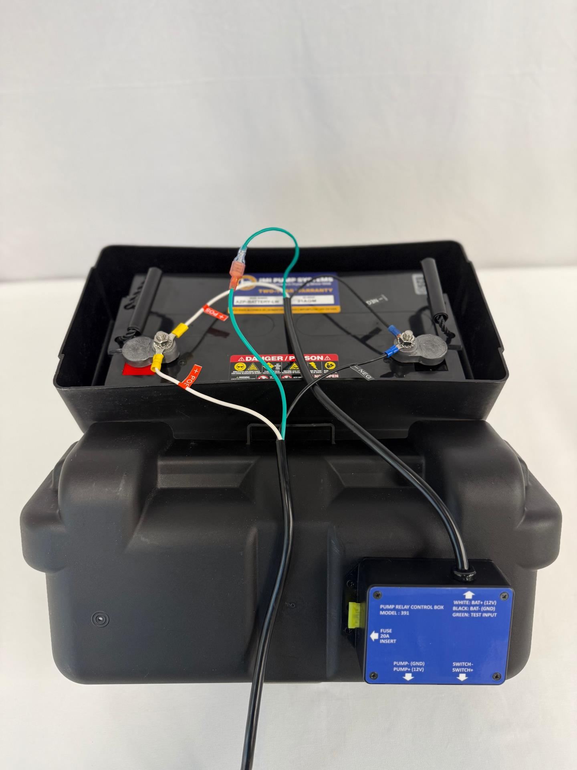
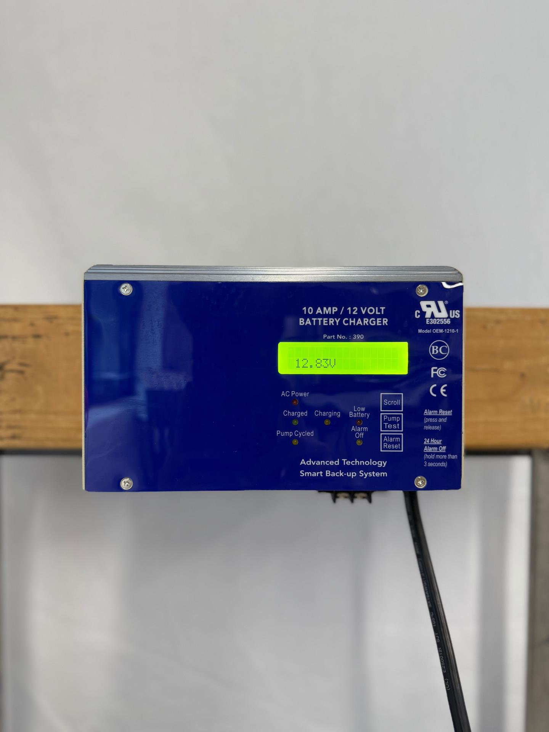
Wire harness from CONTROL / CHARGER to BATTERY-LW via terminals according to corresponding +/- labels. Affix green test/ground bypass wires.
Alarm will sound, indicating DC power to CONTROL / CHARGER. Voltage should read ~12.8V with full battery.

Slide 9
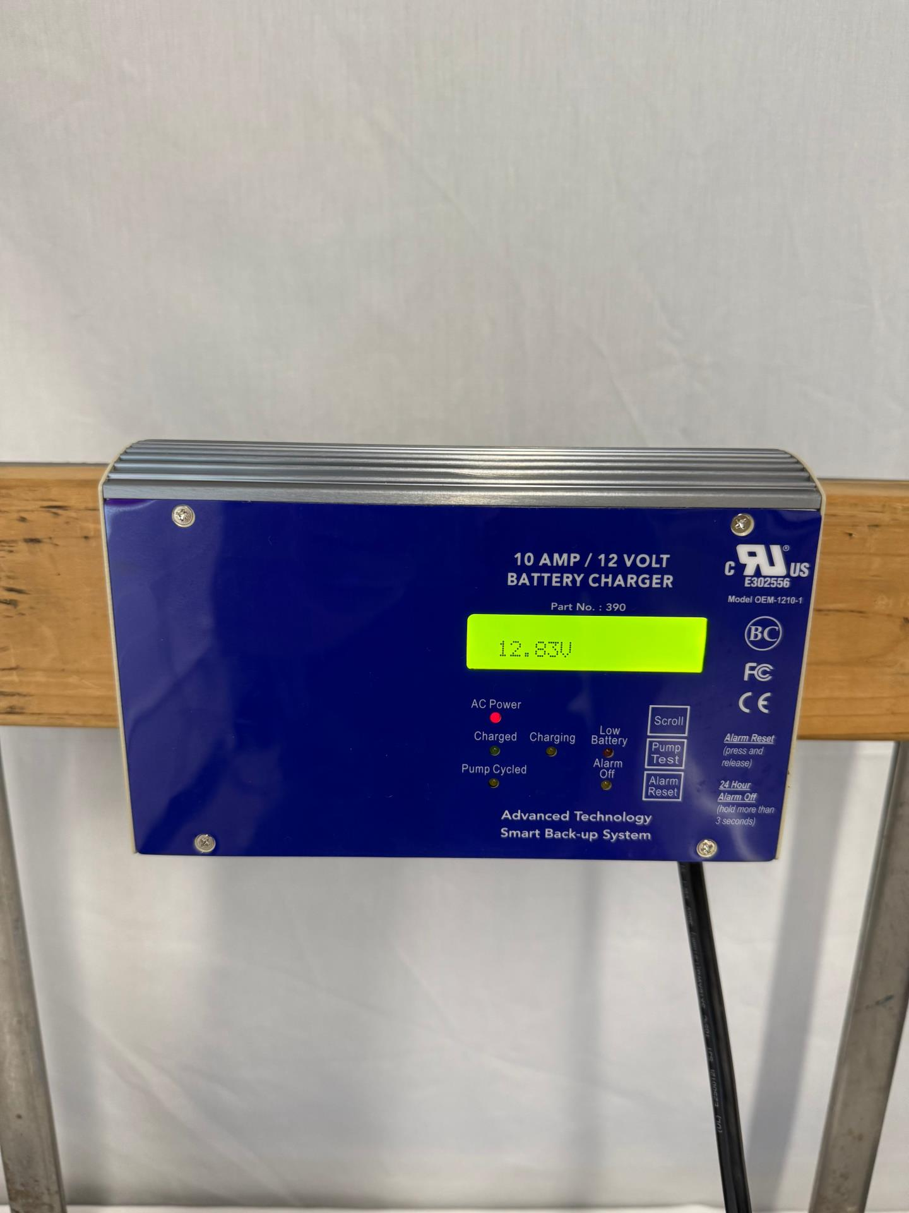
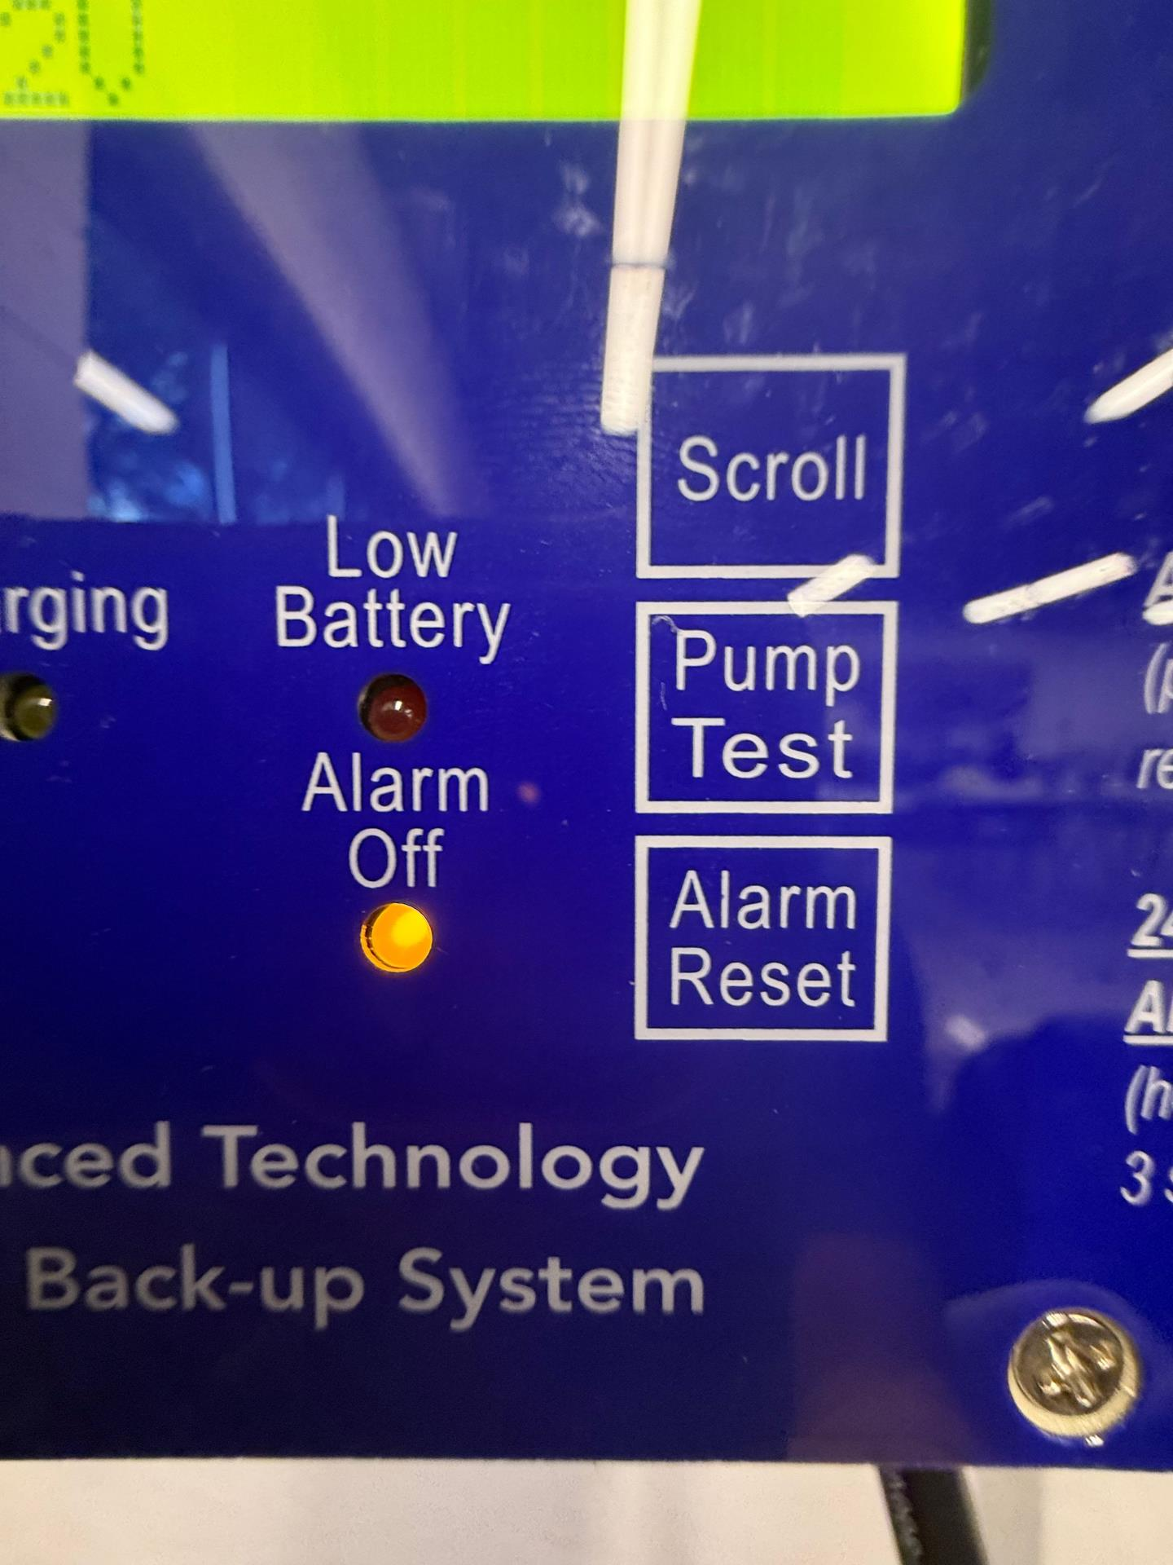
AC Power will flash; indicating DC Power only
Press 'Alarm Reset' to temporarily silence; Hold 'Alarm Reset' to silence for 24 hours. Make sure alarm is ON (light off) before leaving site.

Slide 10
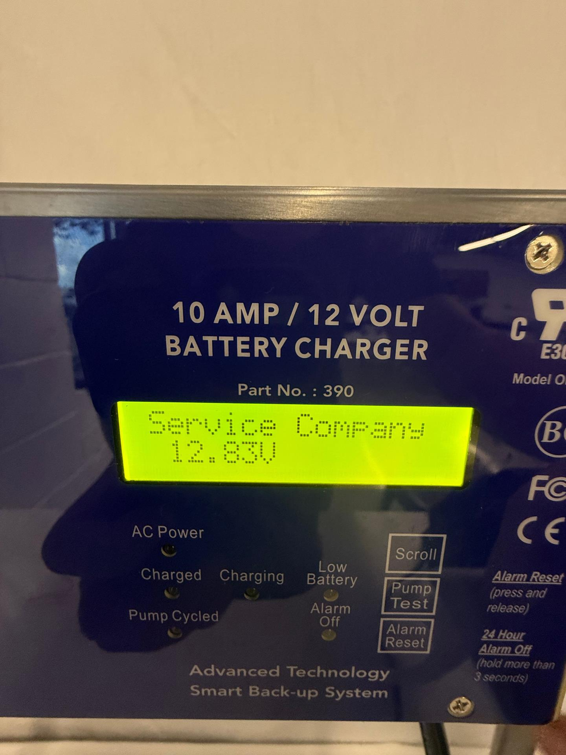
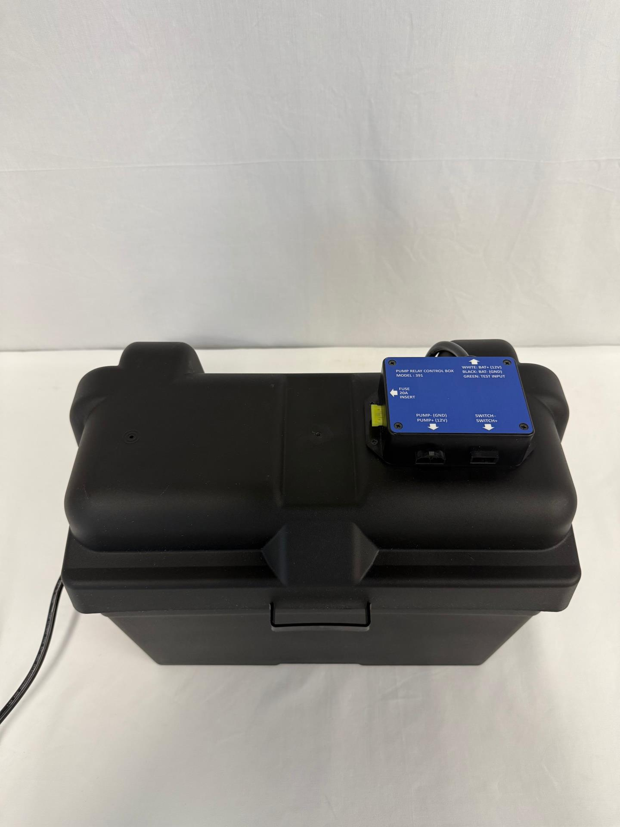
Service Company & Phone number will flash when 'Alarm Reset' is pressed.
Close BATTERY BOX with wiring harness inside. Cord to RELAY BOX & CONTROL / CHARGER should show below harness, at black cord only.

Slide 11
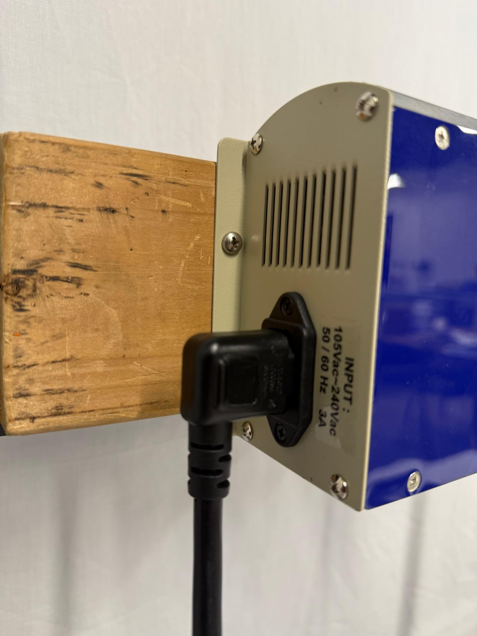
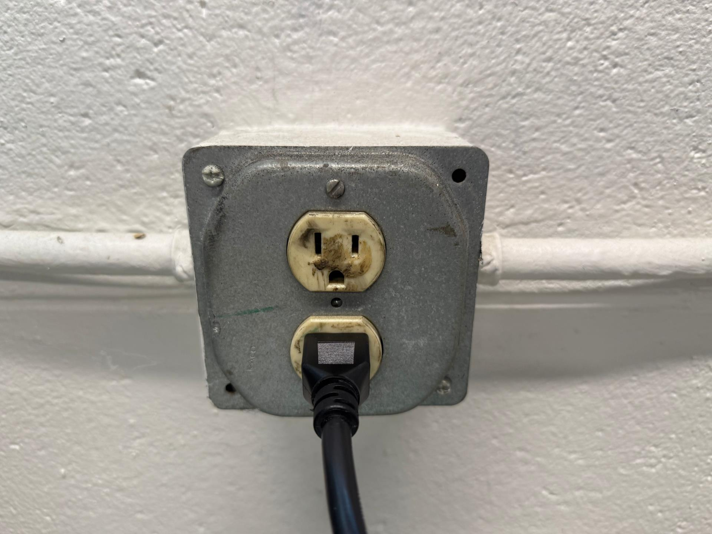
Plug CHARGER CORD into designated input terminal on CONTROL / CHARGER
Plug CHARGER CORD into 115V wall socket; UL recommends 5+ feet off ground

Slide 12
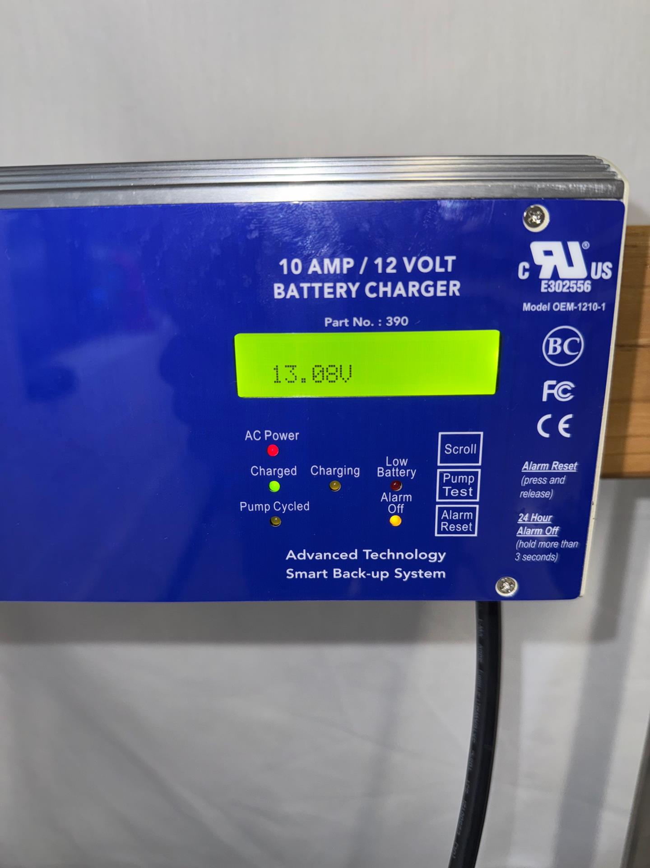
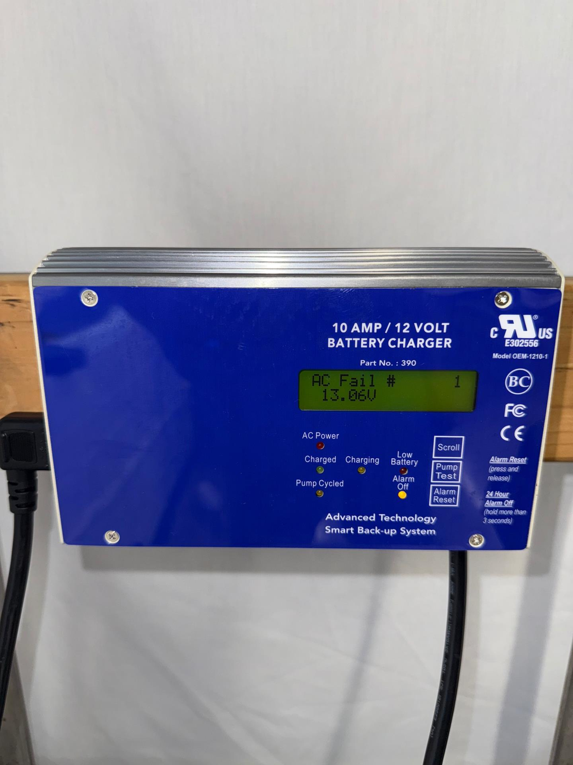
'AC Power' light will turn solid red. Green 'Charged' light will come on. Voltage will increase to ~13.1V with AC Power now supplying the primary power source.
When unit is unplugged from 115V AC Power, 'AC Fail #' counter will appear on the screen and alarm will sound (if not silenced).

Slide 13
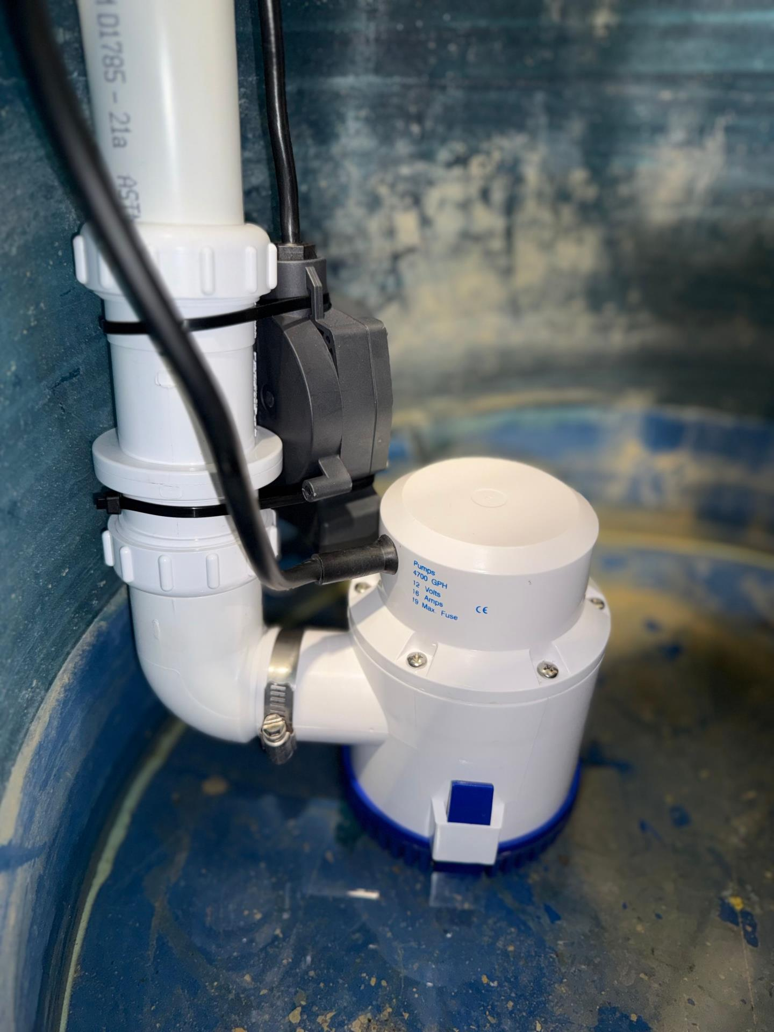
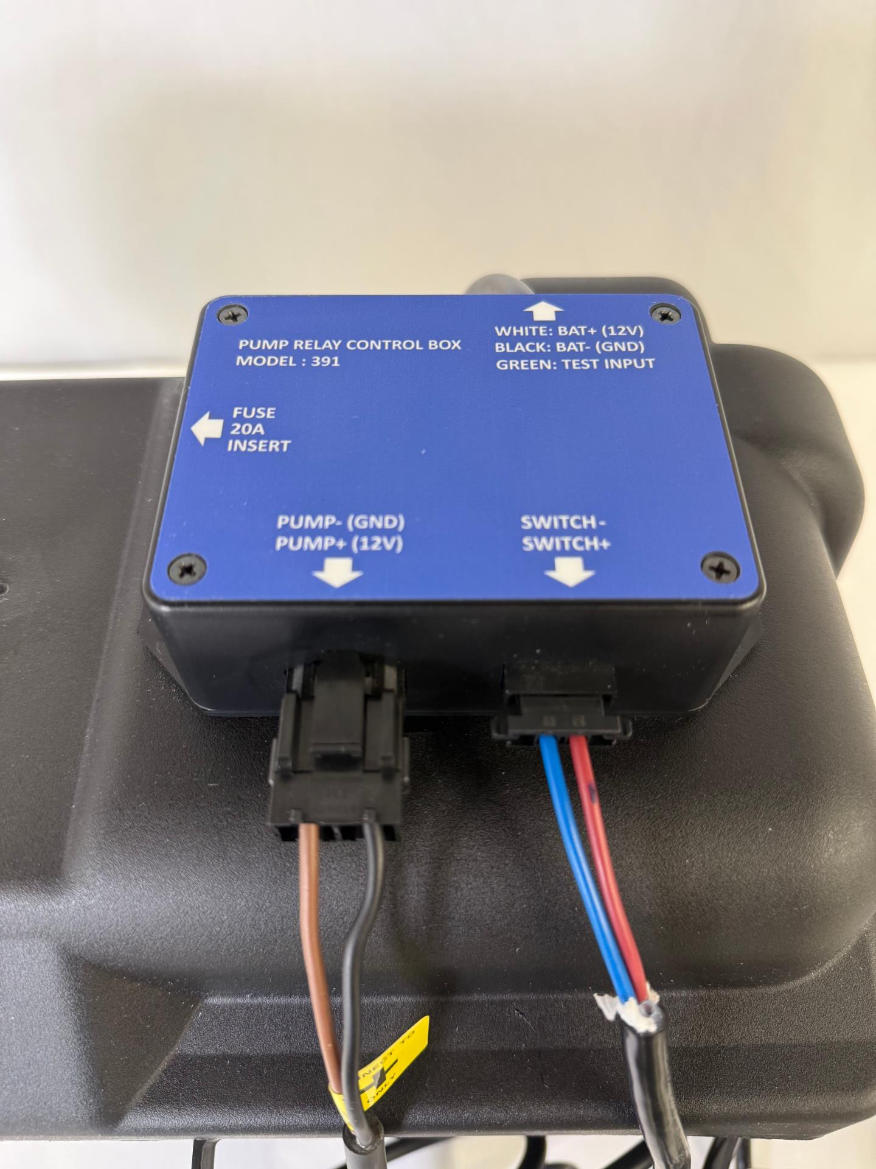
Drop DC PUMP & PRESSURE SWITCH assembly into pit. Ensure pressure switch points away from inlet.
Plug in DC PUMP snap-in connection to 'Pump' terminal and PRESSURE SWITCH snap-in connection to 'Switch' terminal. Hold 'Pump Test' button to test system. 'Scroll' button reveals 'Cycle Count'.

