Slide 1
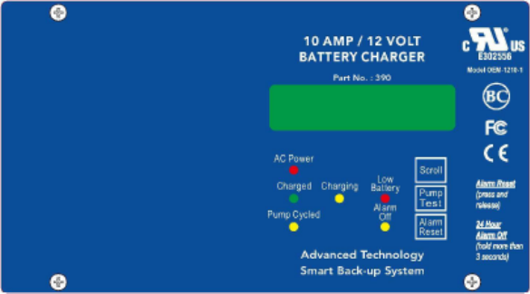

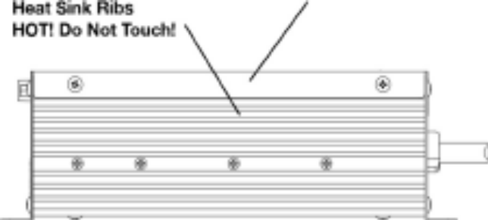
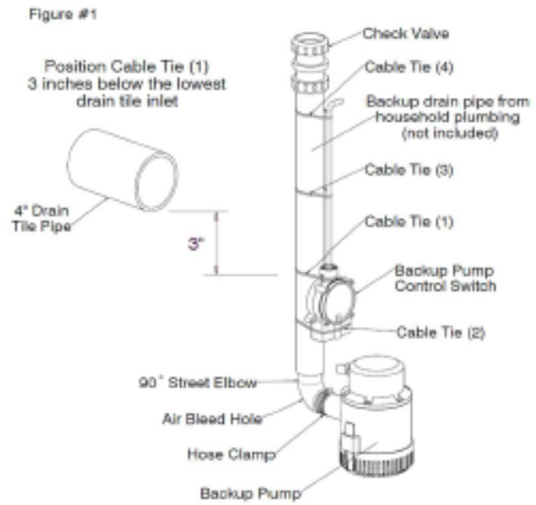
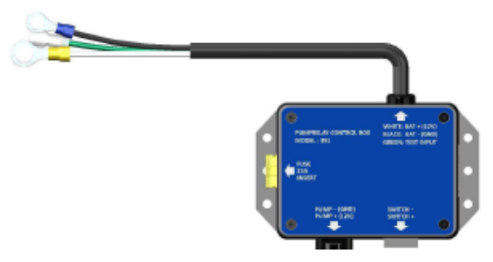
Quick Install Guide v3
JMI-POM
Quality Tested:______________
Programmed:______________

Slide 2
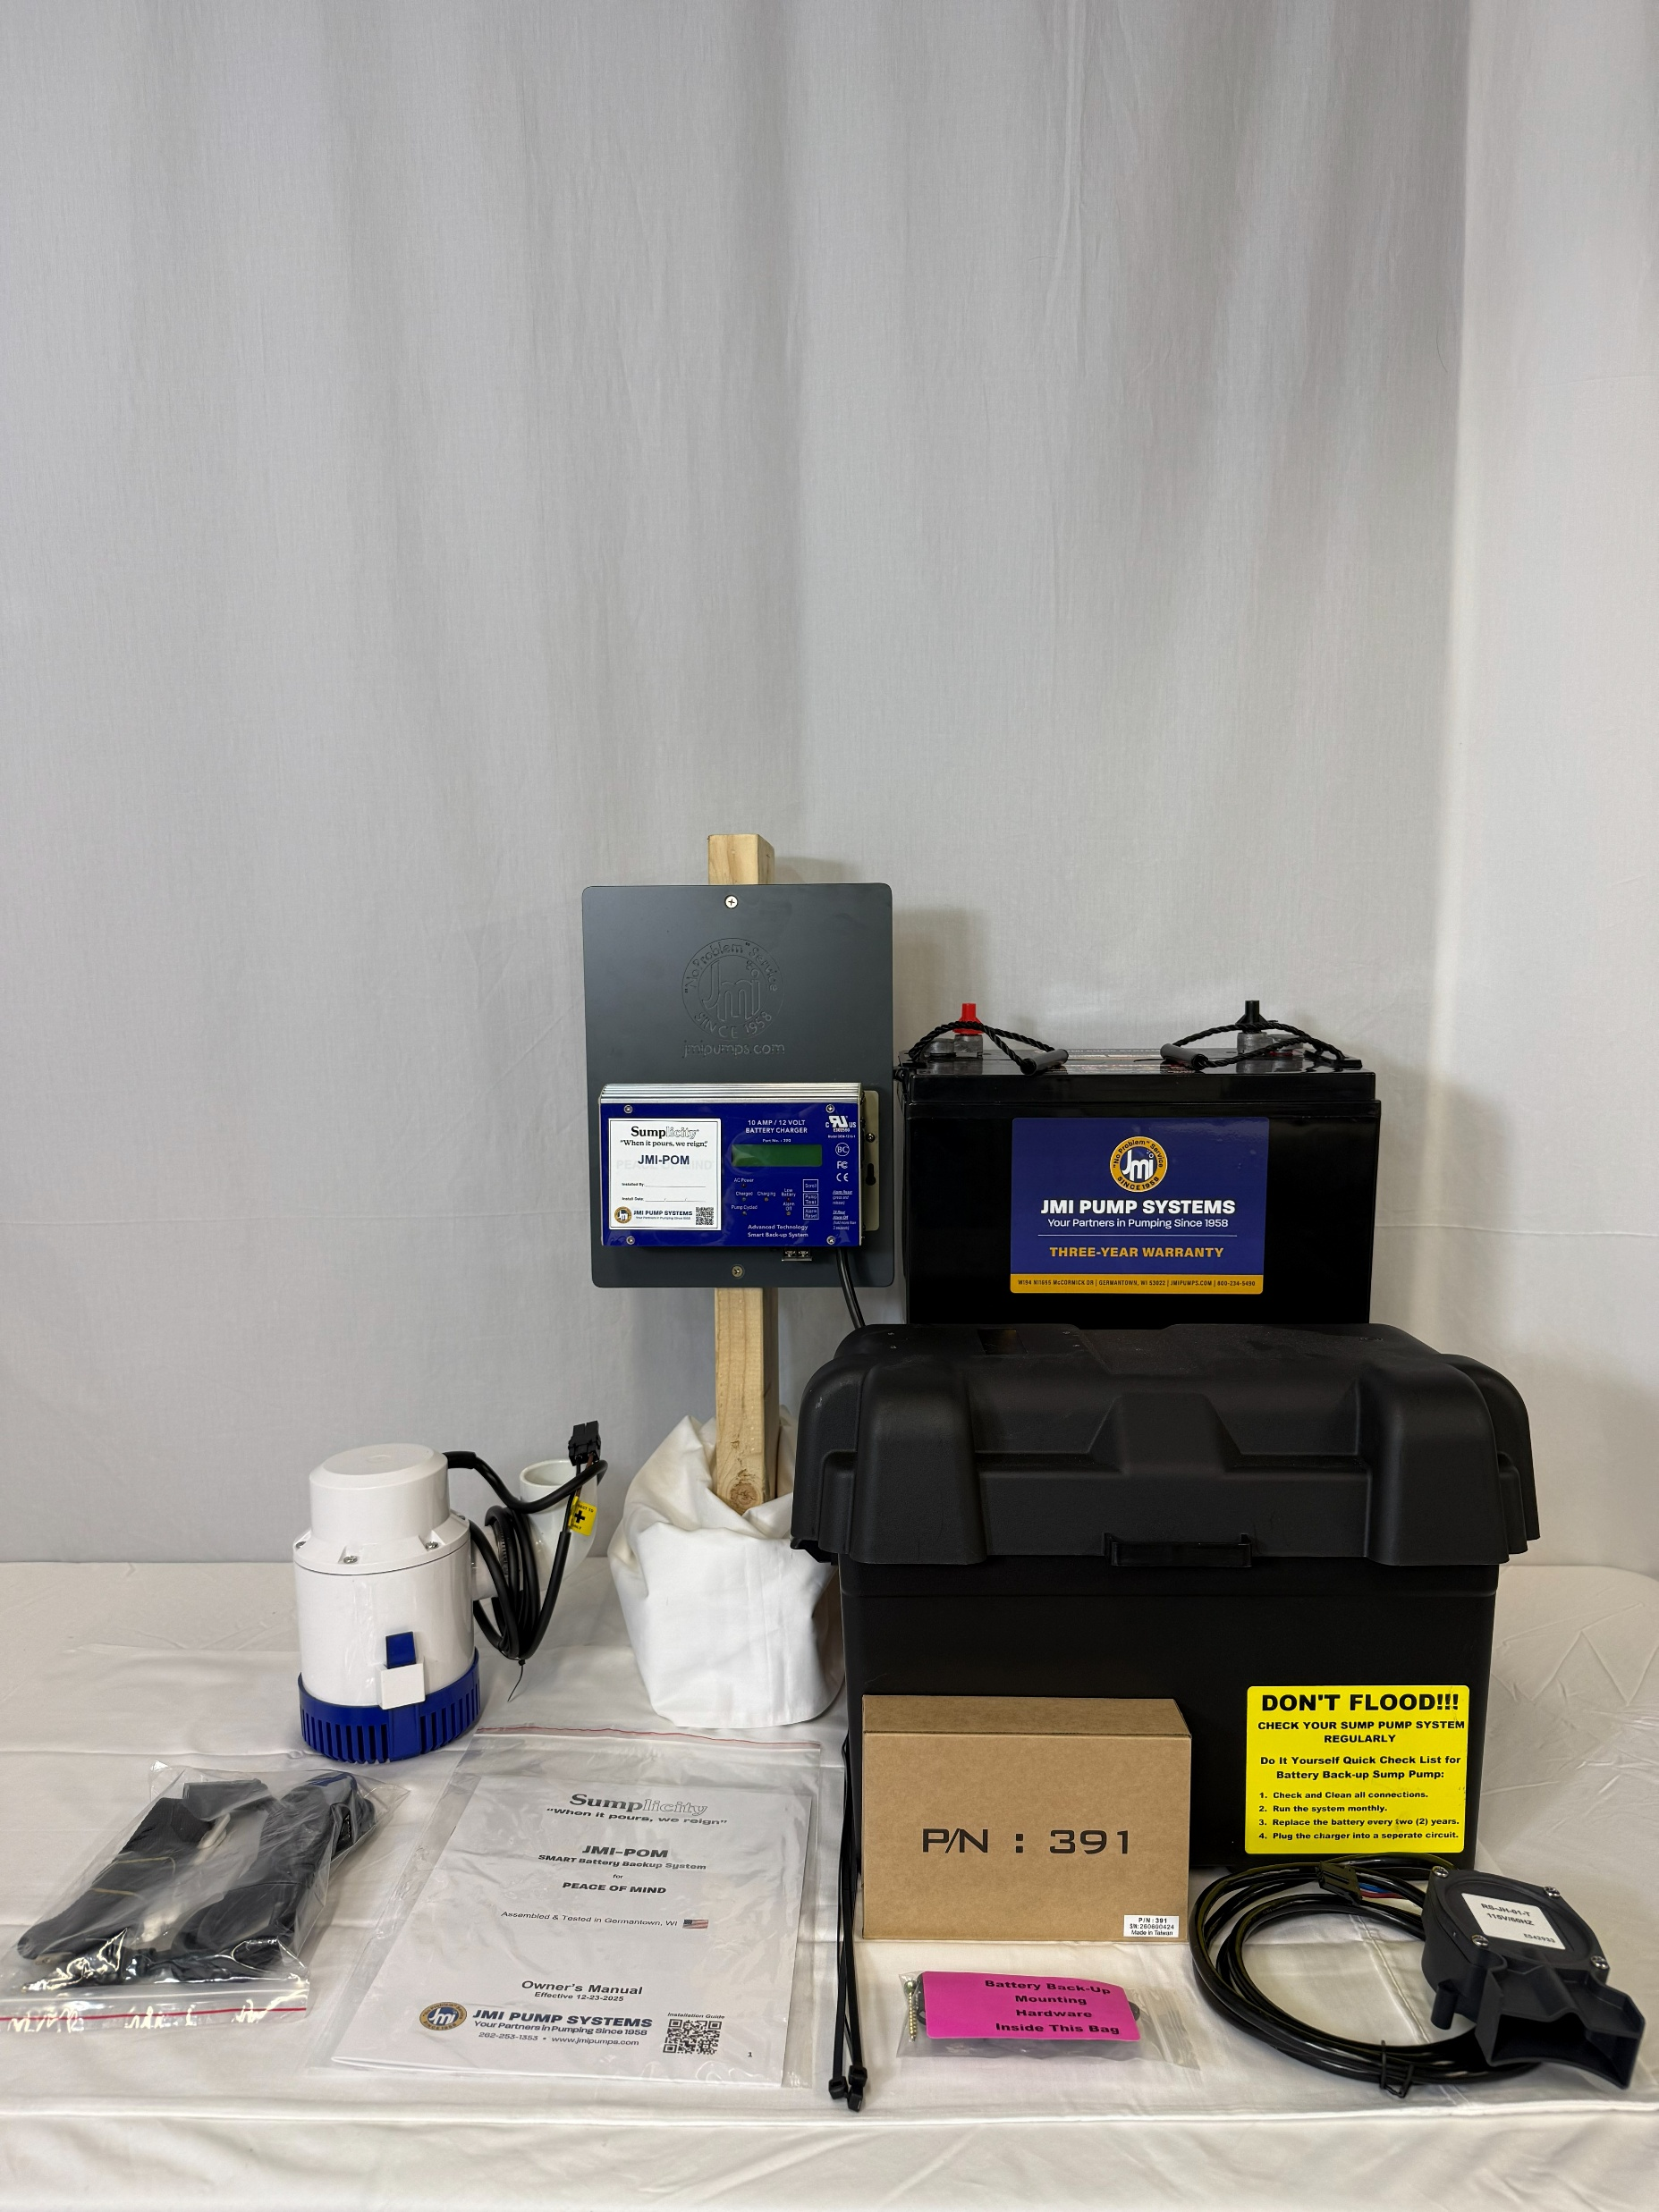
POM System components

Slide 3
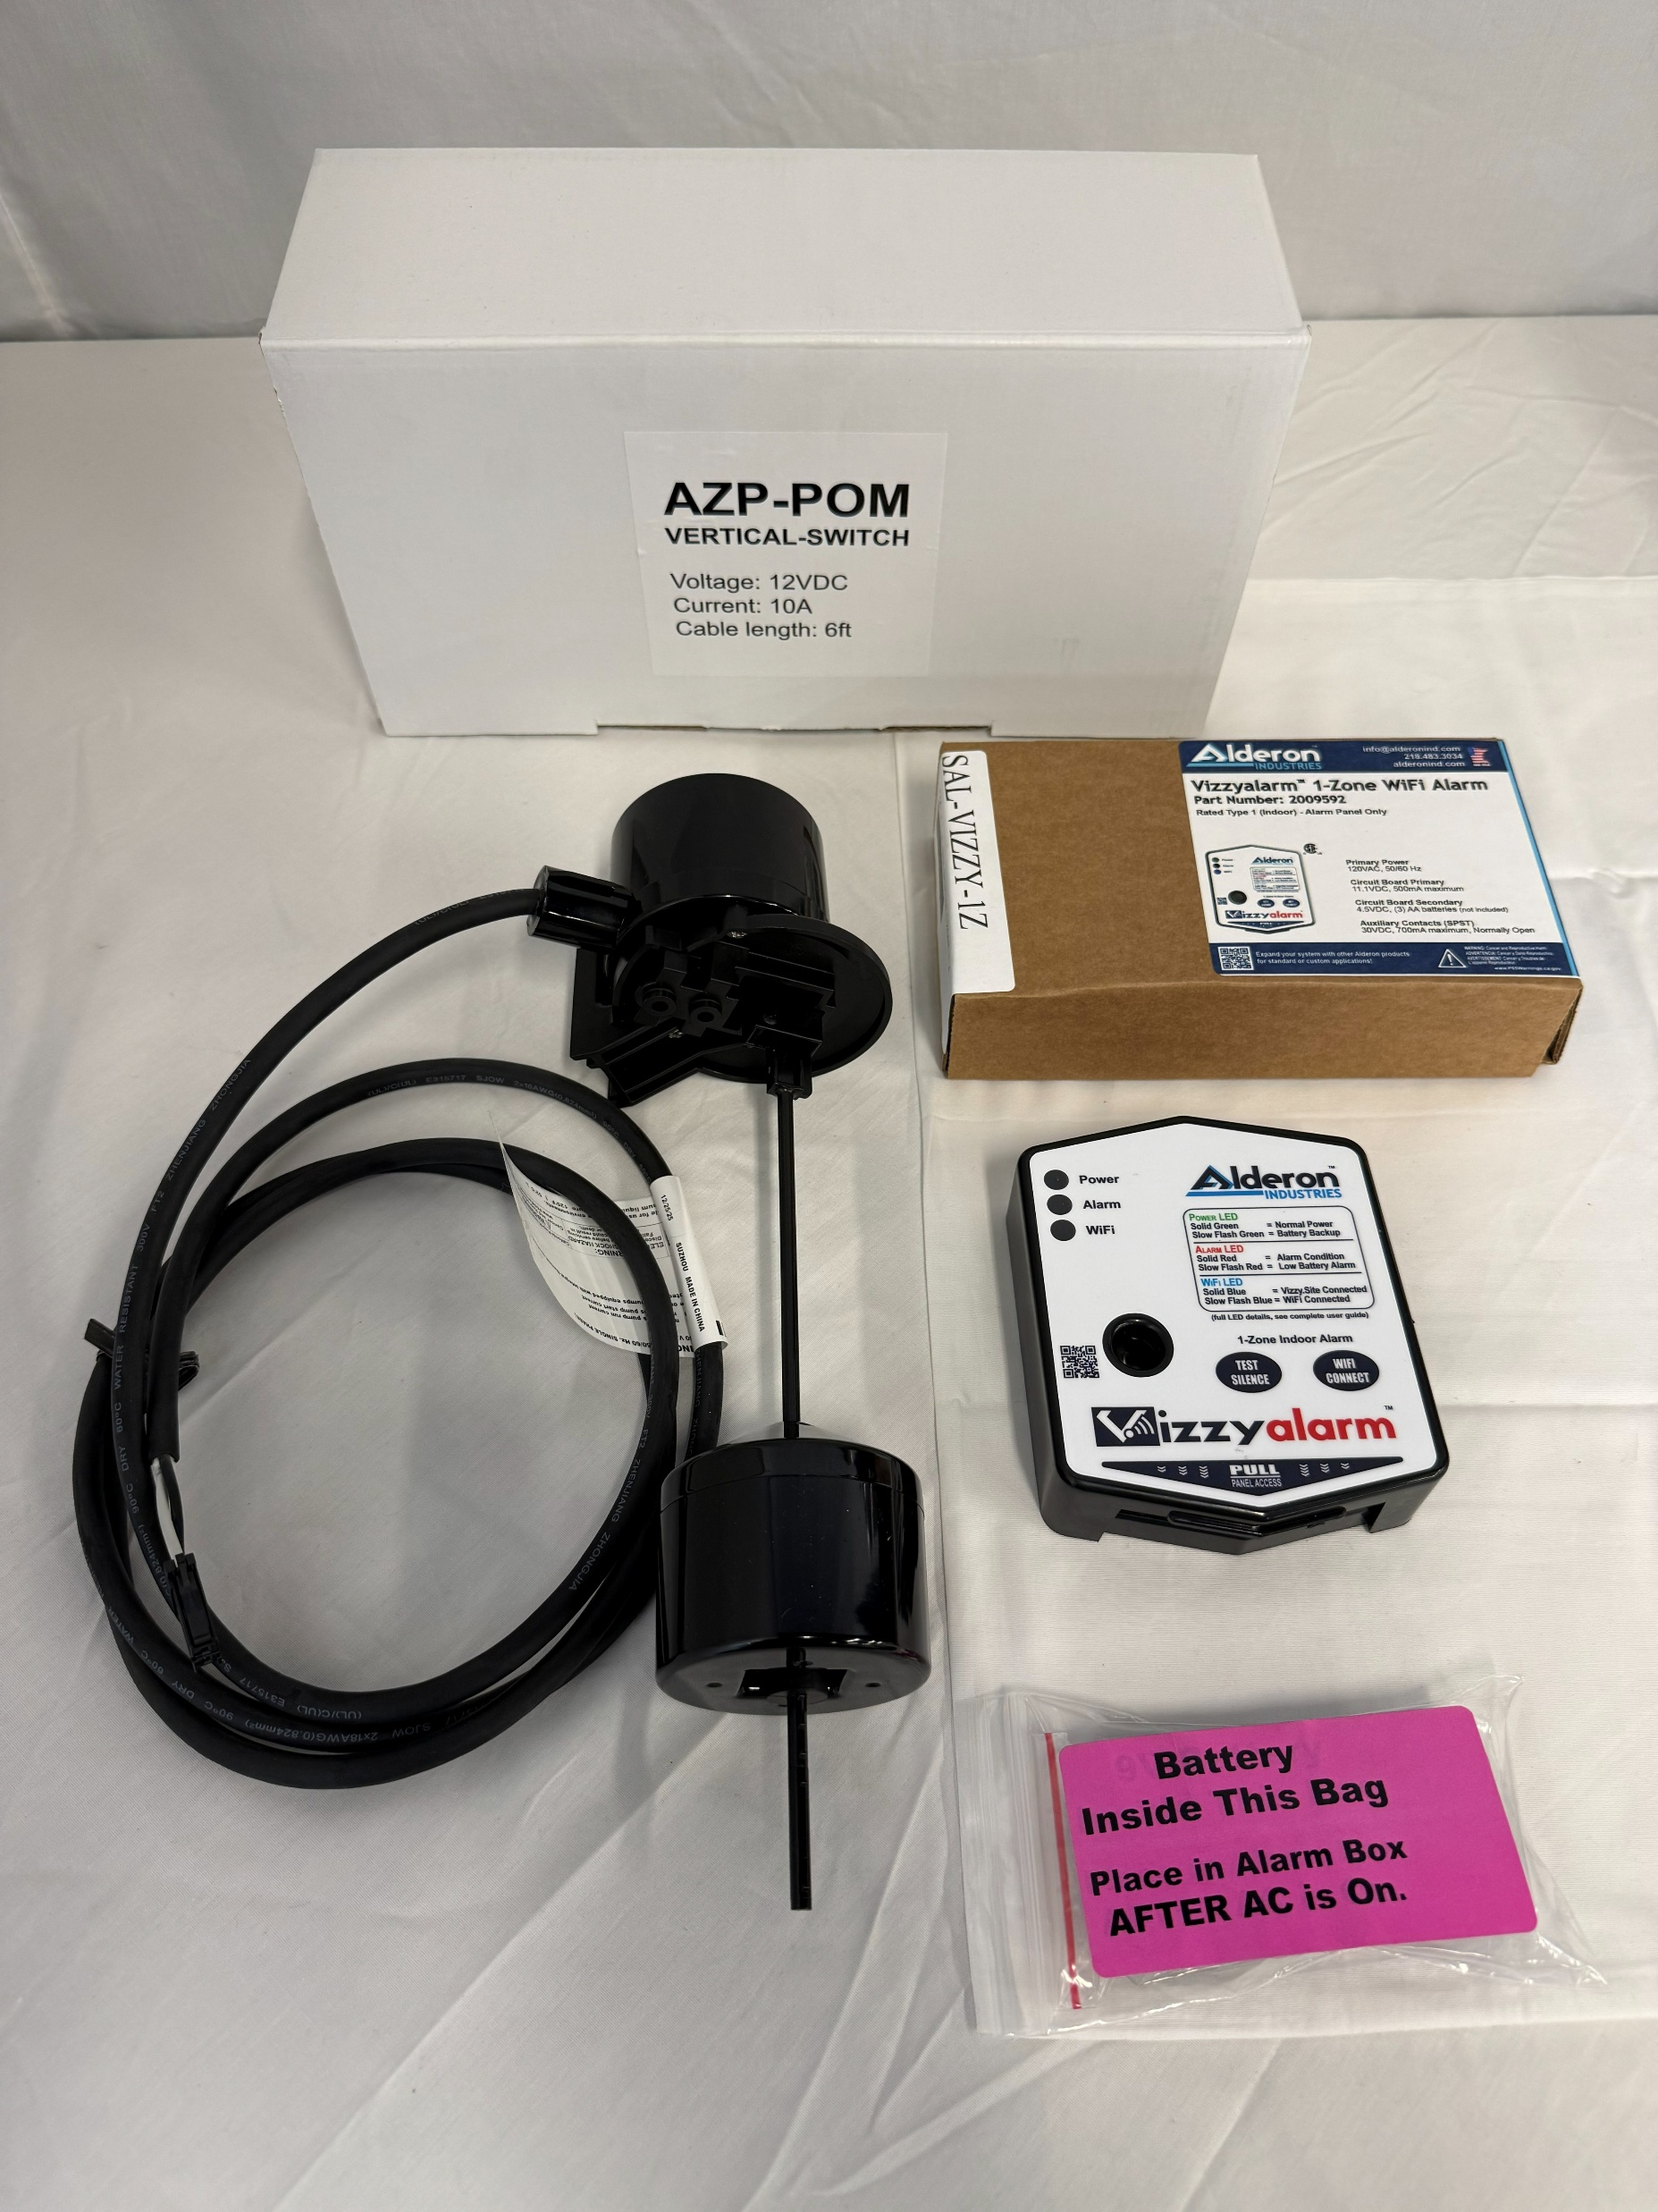
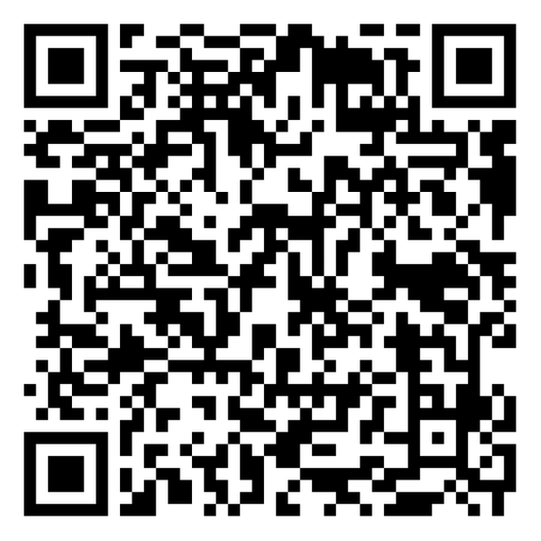
Optional system components
SCAN to order WiFi alarm

Slide 4
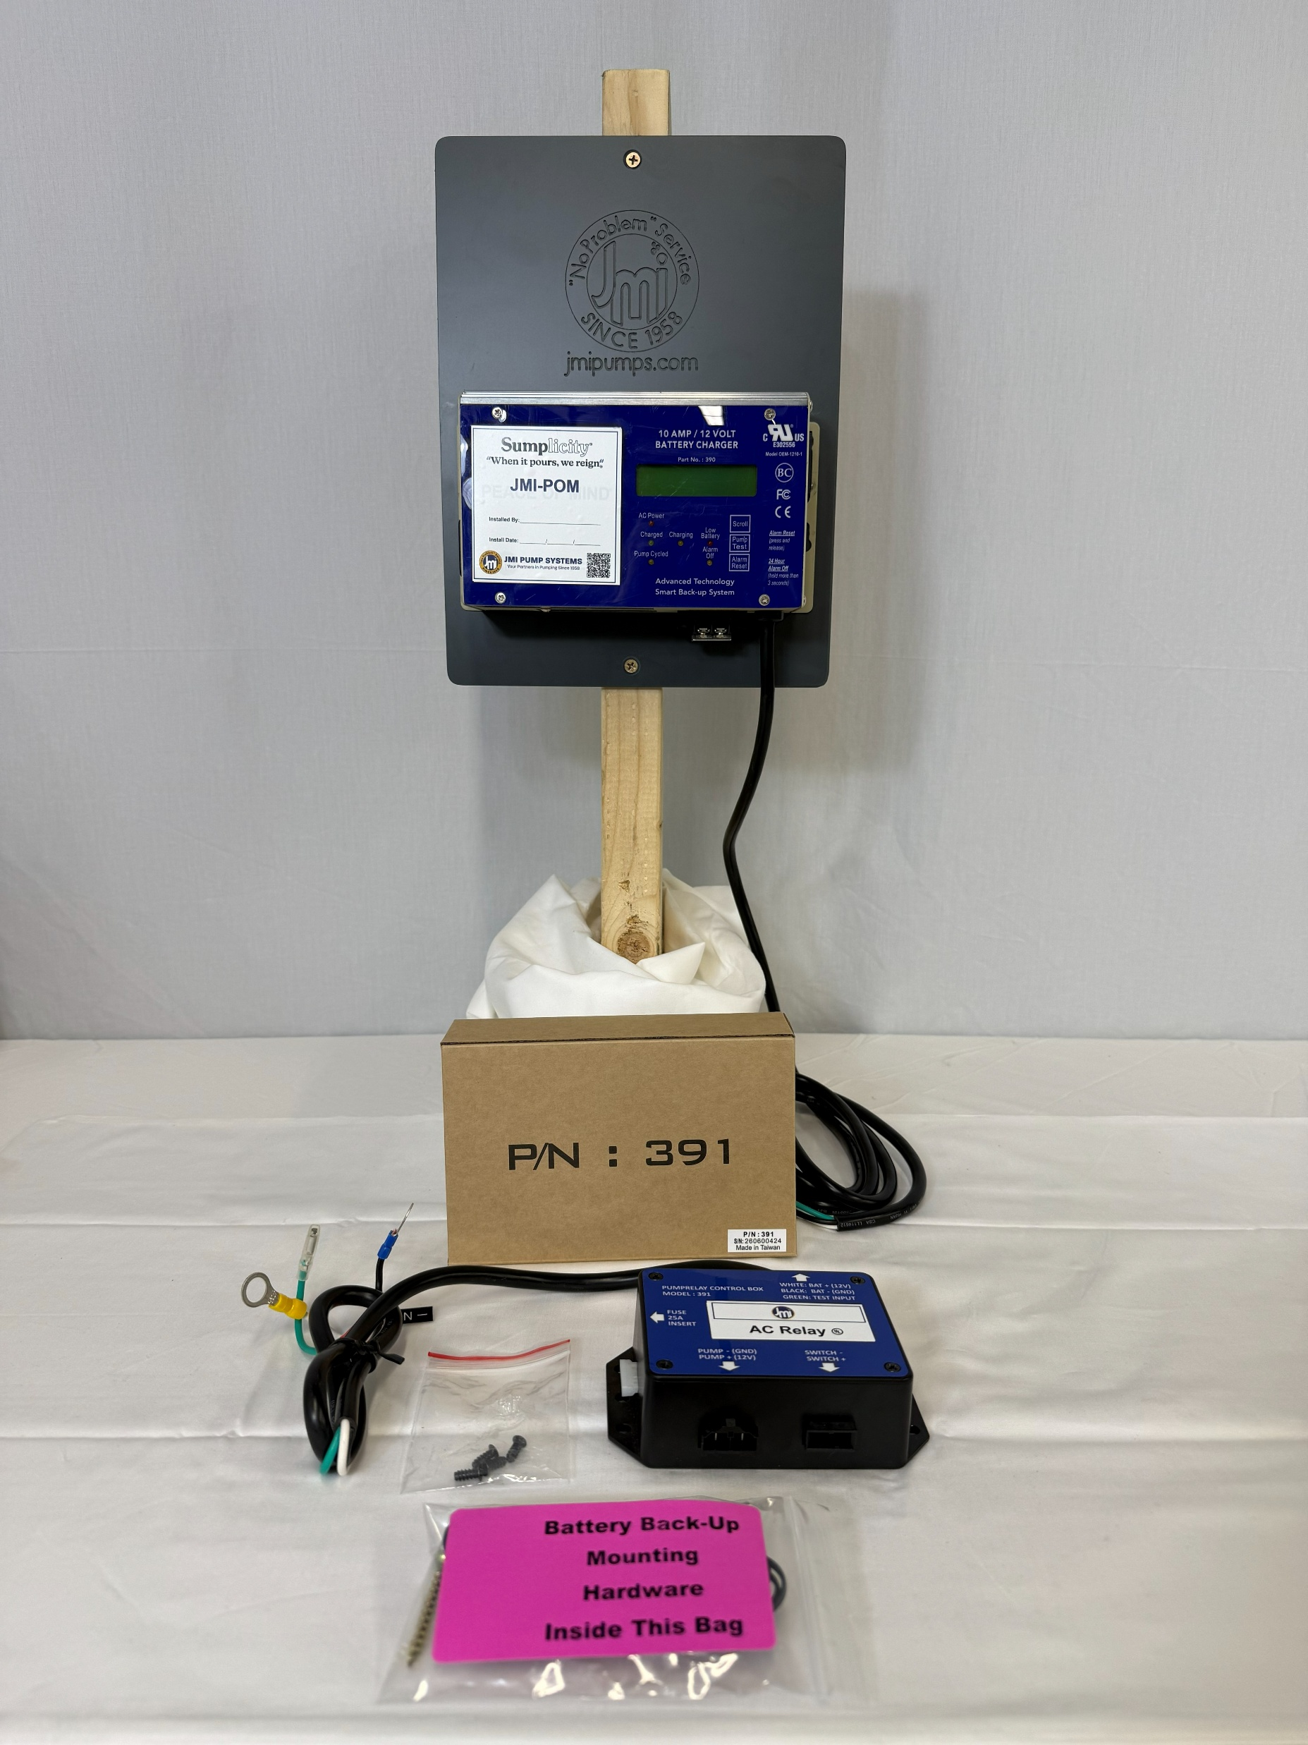
PN - 391 is AC RELAY

Slide 5
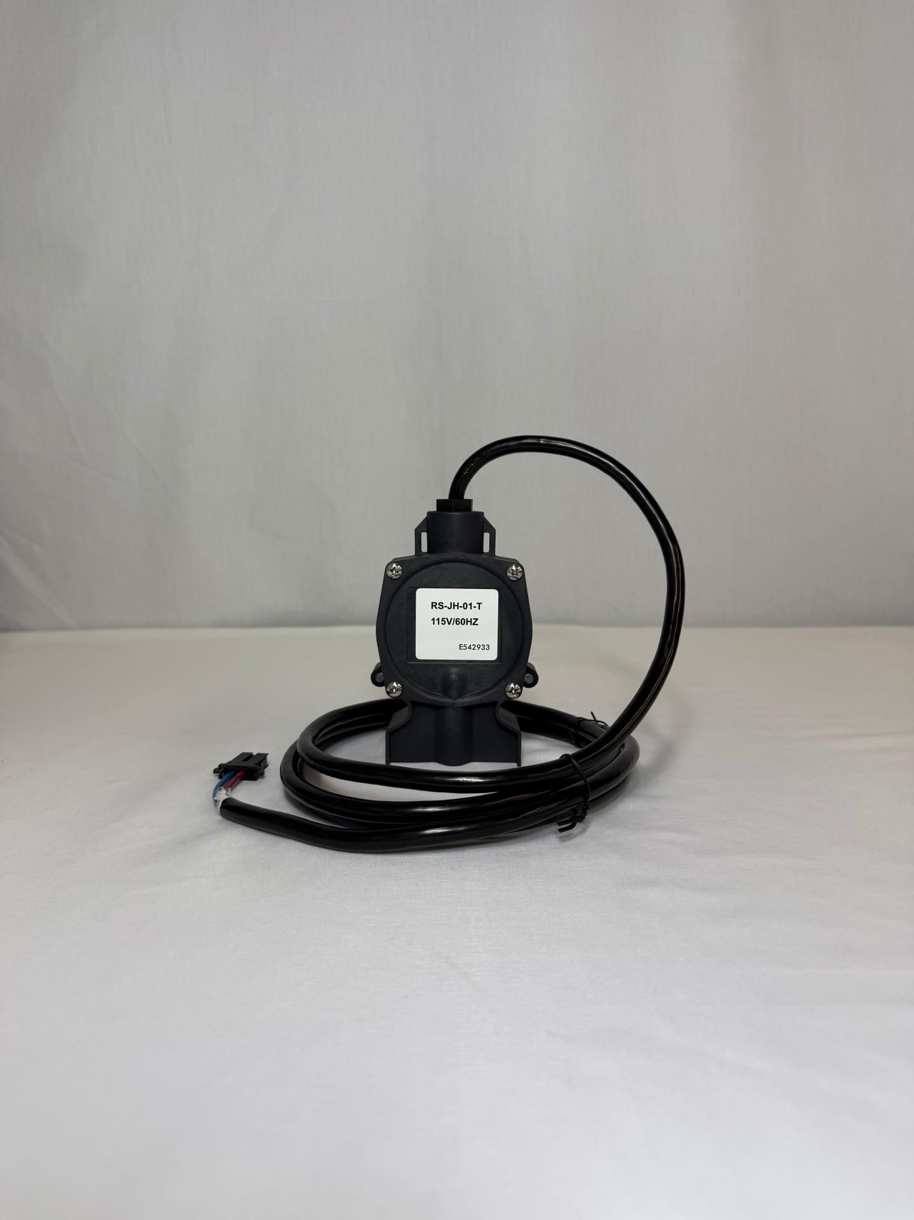
RS-JH-01-T is PRESSURE SWITCH

Slide 6
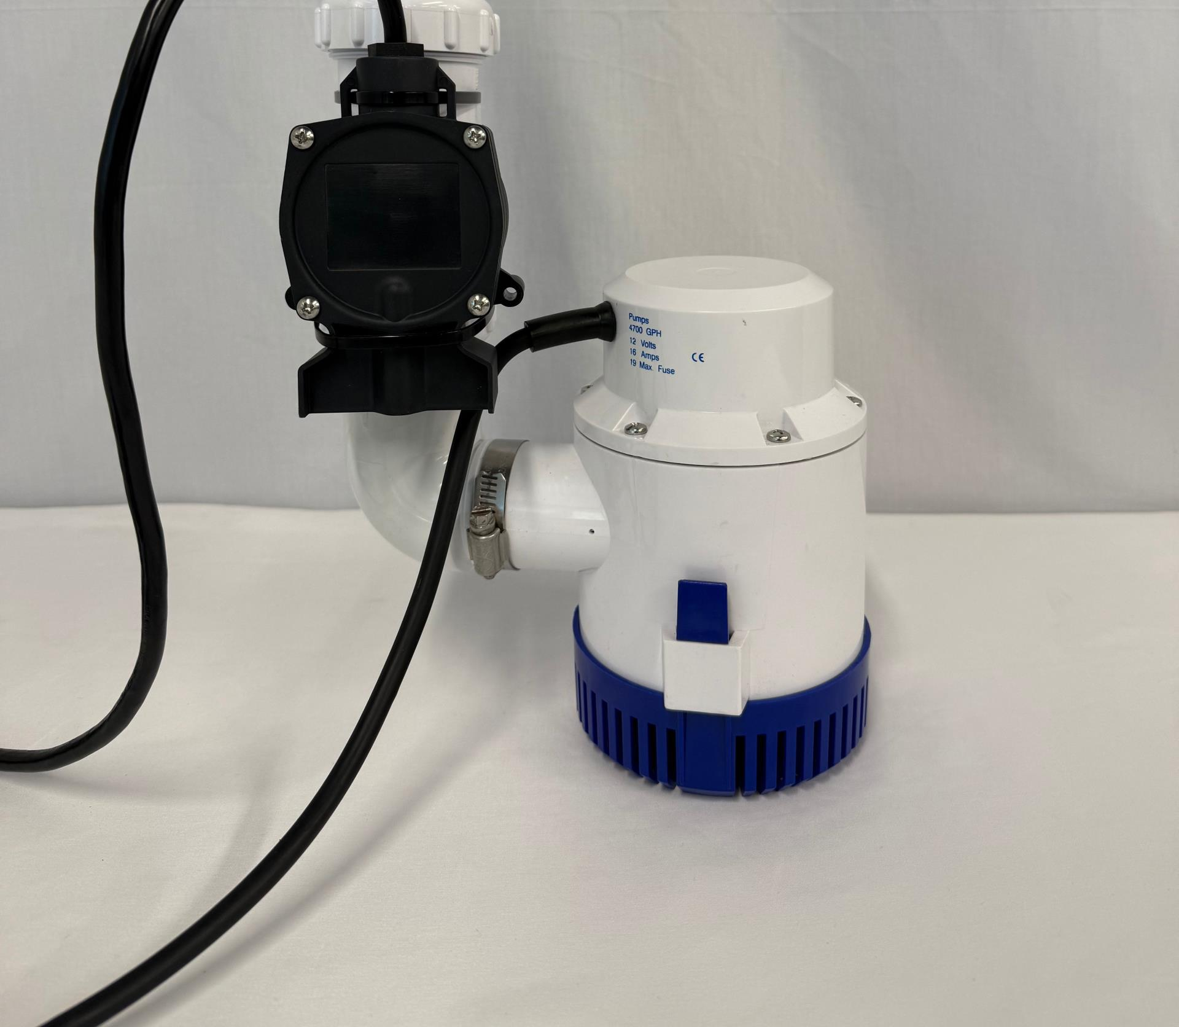
Supply Pipe and Check Valve. Assemble PRESSURE SWITCH & DC PUMP with ZIP TIES. DC Pump ON point should be ~2" above primary activation.

Slide 7
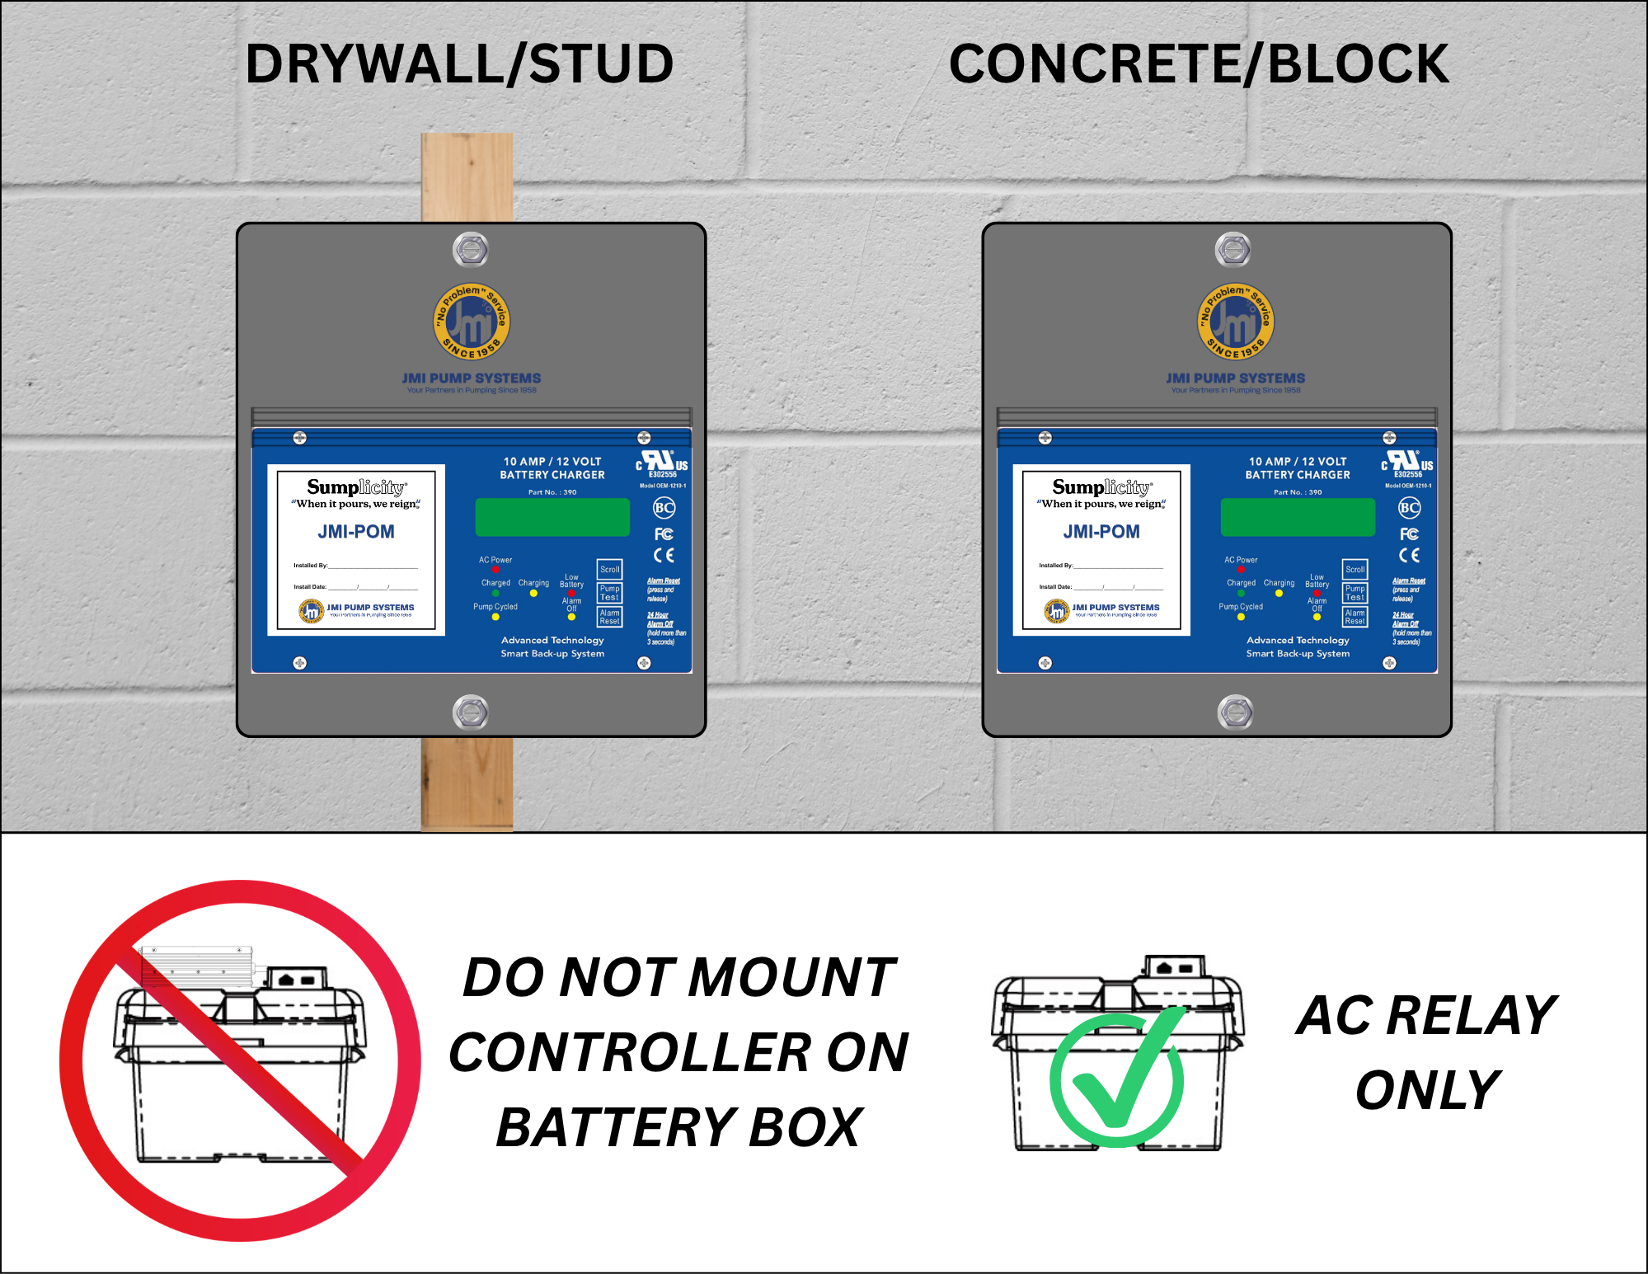

Slide 8
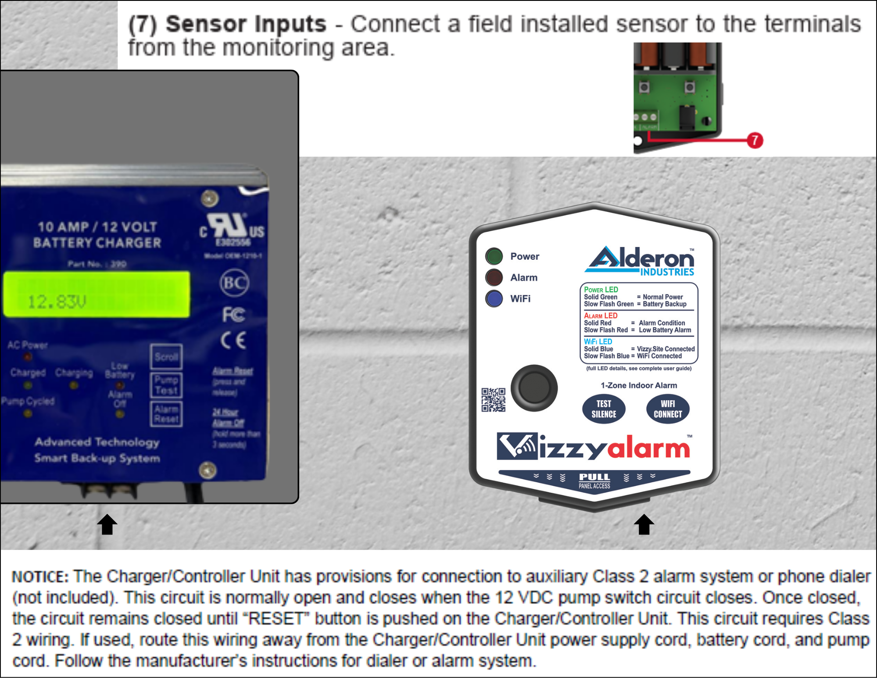
USE PROVIDED CLASS 2 WIRE TO CONNECT WIFI ALARM TO CONTROLLER
NOTE: BATTERY BACK-UP NEEDED ON ROUTER DURING POWER OUTAGE

Slide 9
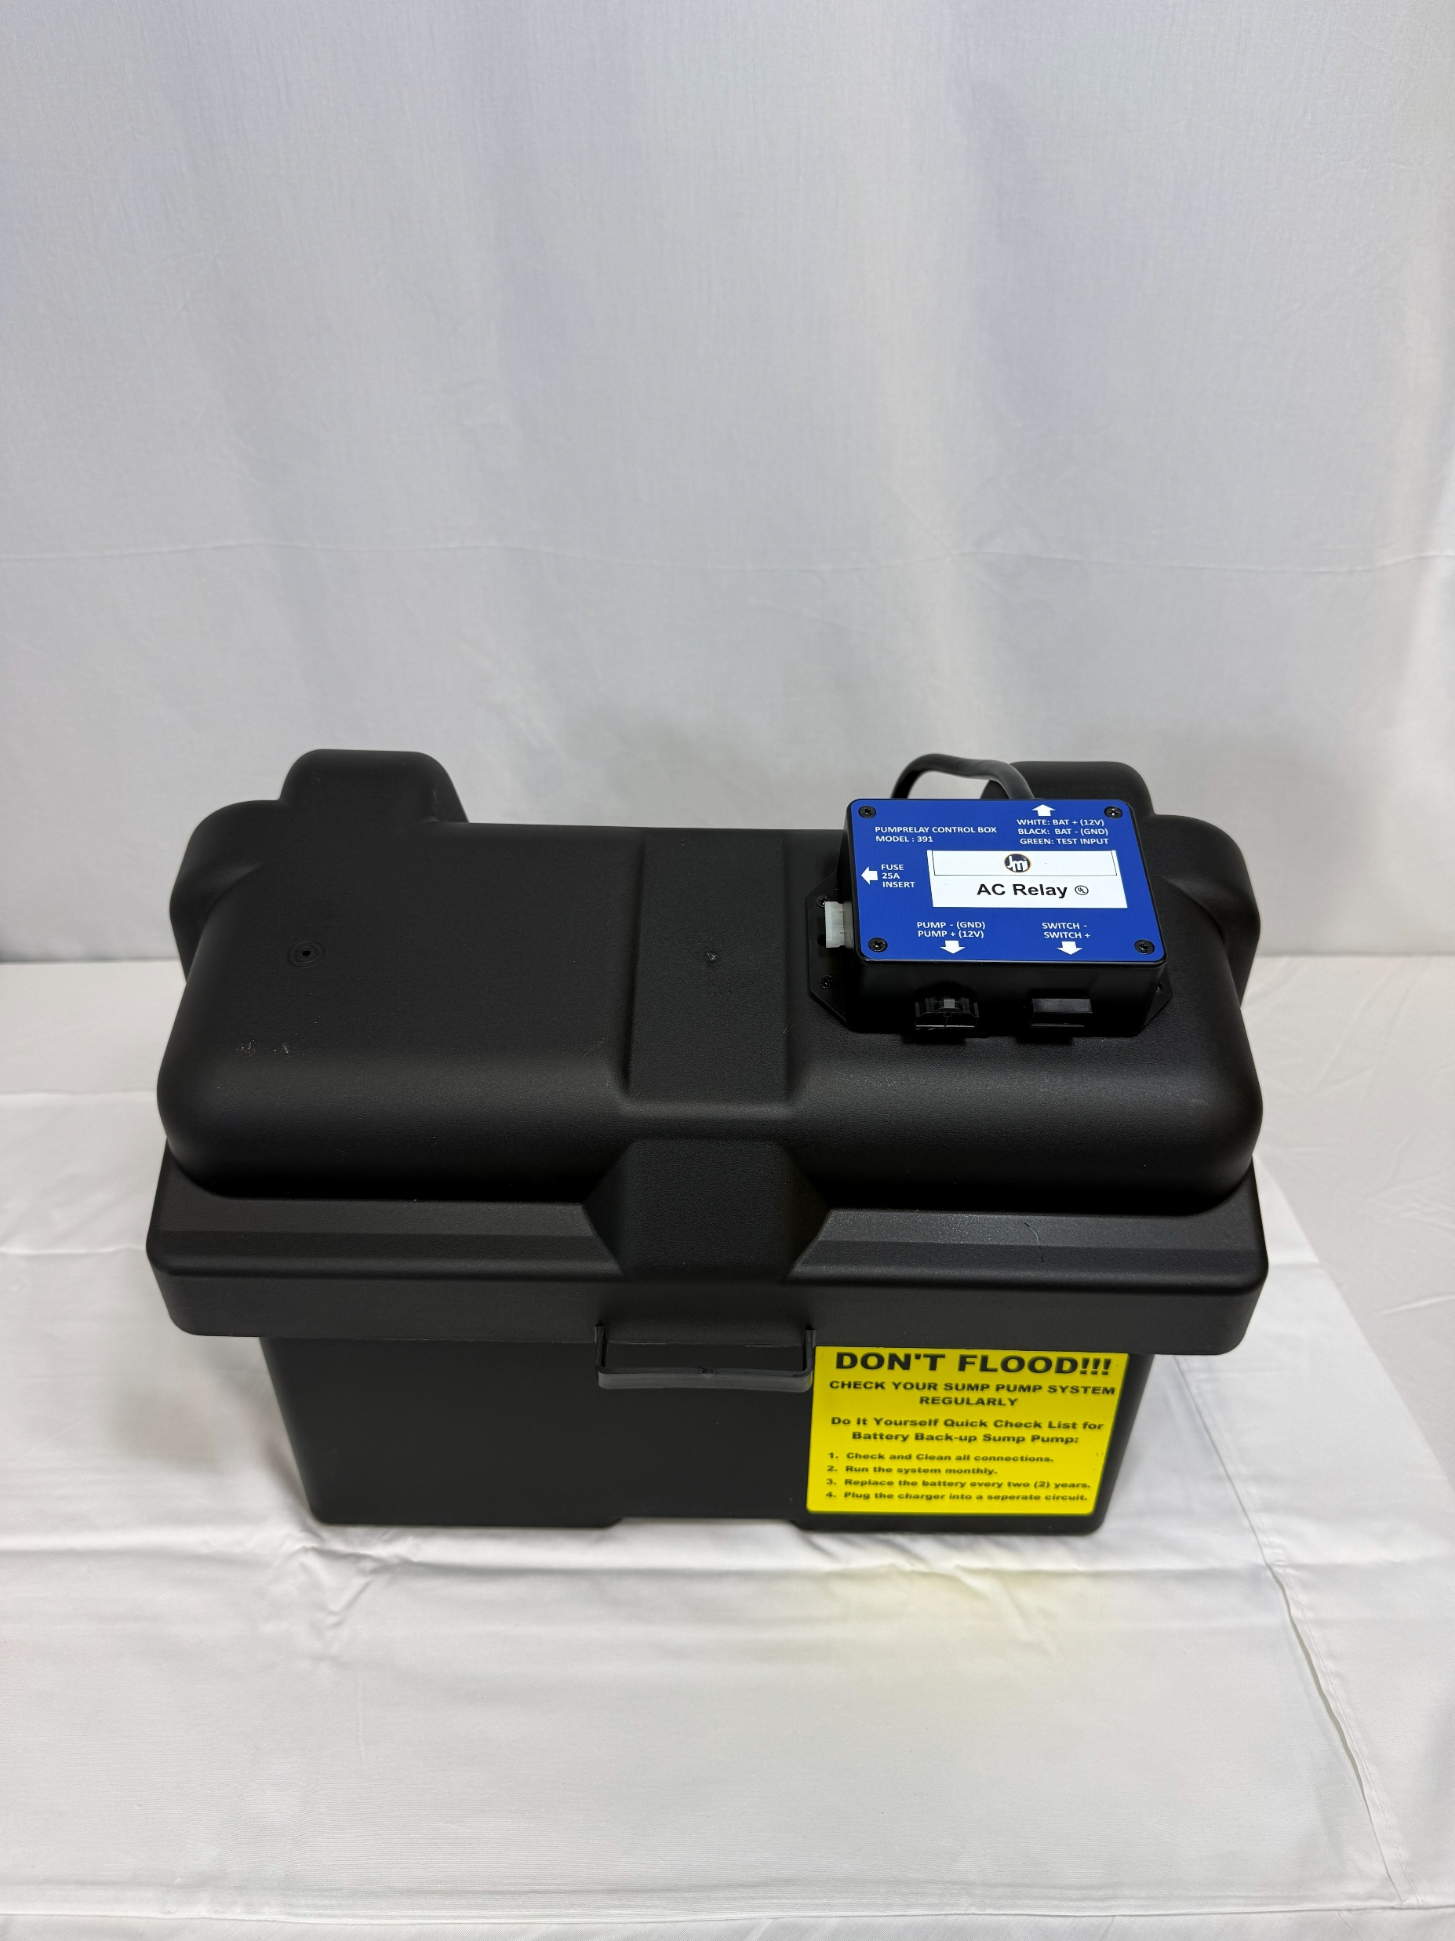
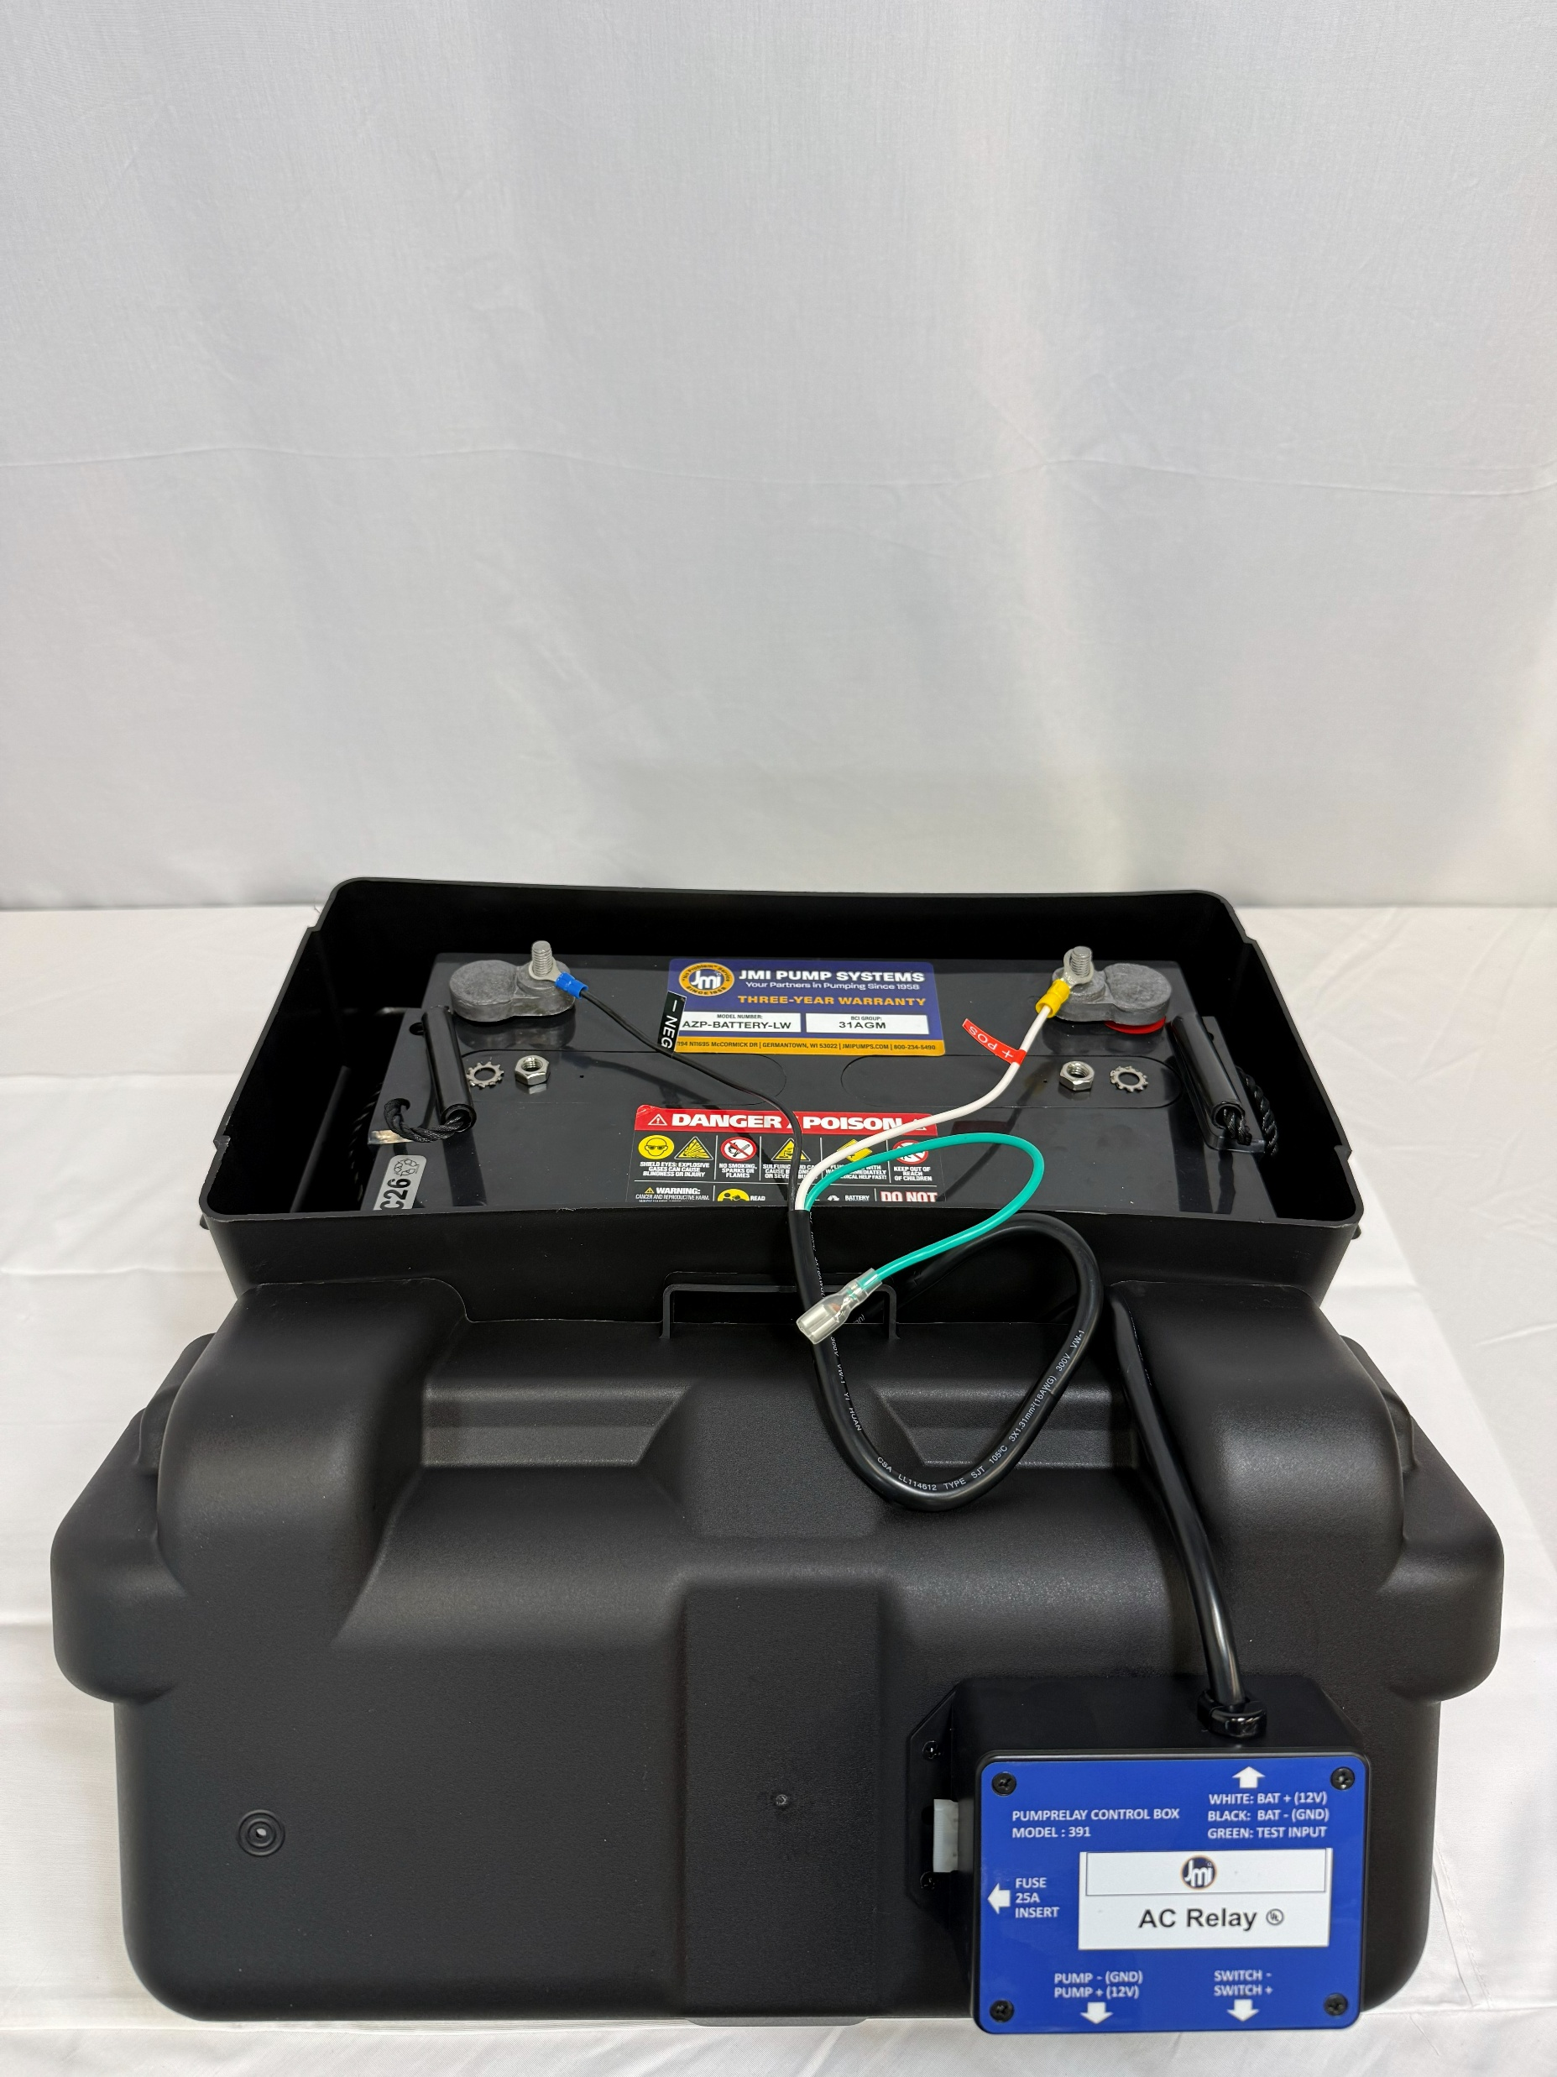
Using (4) black screws provided, mount RELAY BOX to BATTERY BOX via (4) pilot holes
Wire RELAY BOX harness to BATTERY-LW via terminals according to corresponding +/- labels

Slide 10
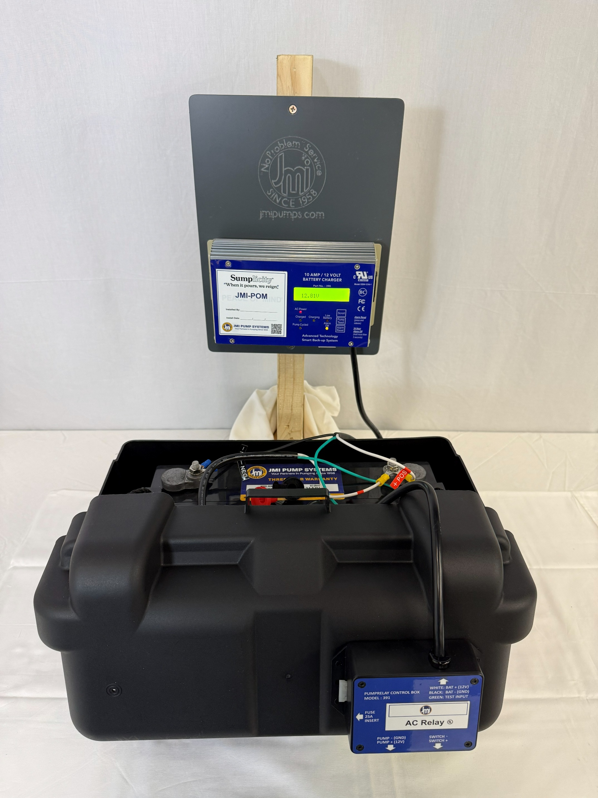
Wire harness from CONTROL / CHARGER to BATTERY-LW via terminals according to corresponding +/- labels. Affix green test/ground bypass wires.
Voltage should read ~12.8V with full battery.

Slide 11
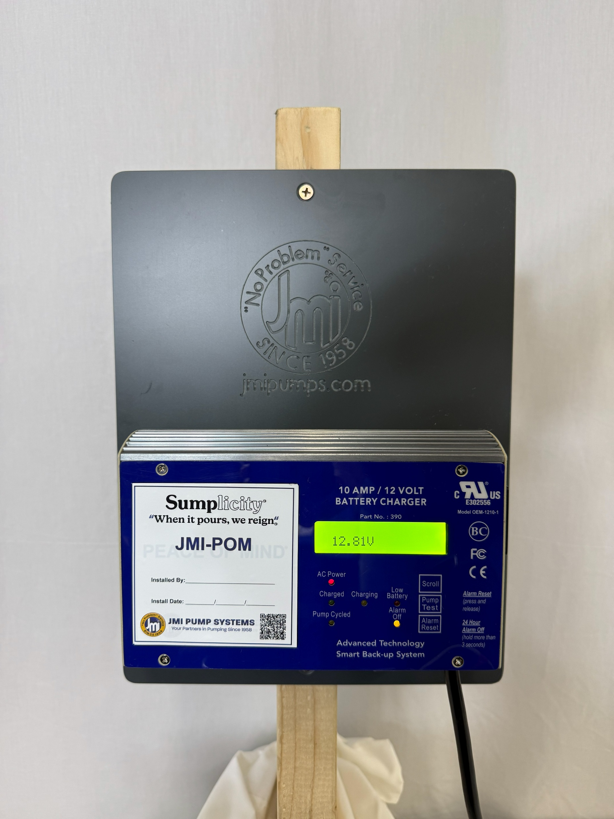
AC Power will flash; indicating DC Power only
Press 'Alarm Reset' to temporarily silence; Hold 'Alarm Reset' to silence for 24 hours. Make sure alarm is ON (light off) before leaving site. Weekly test will occur 7 days from Alarm Reset.

Slide 12
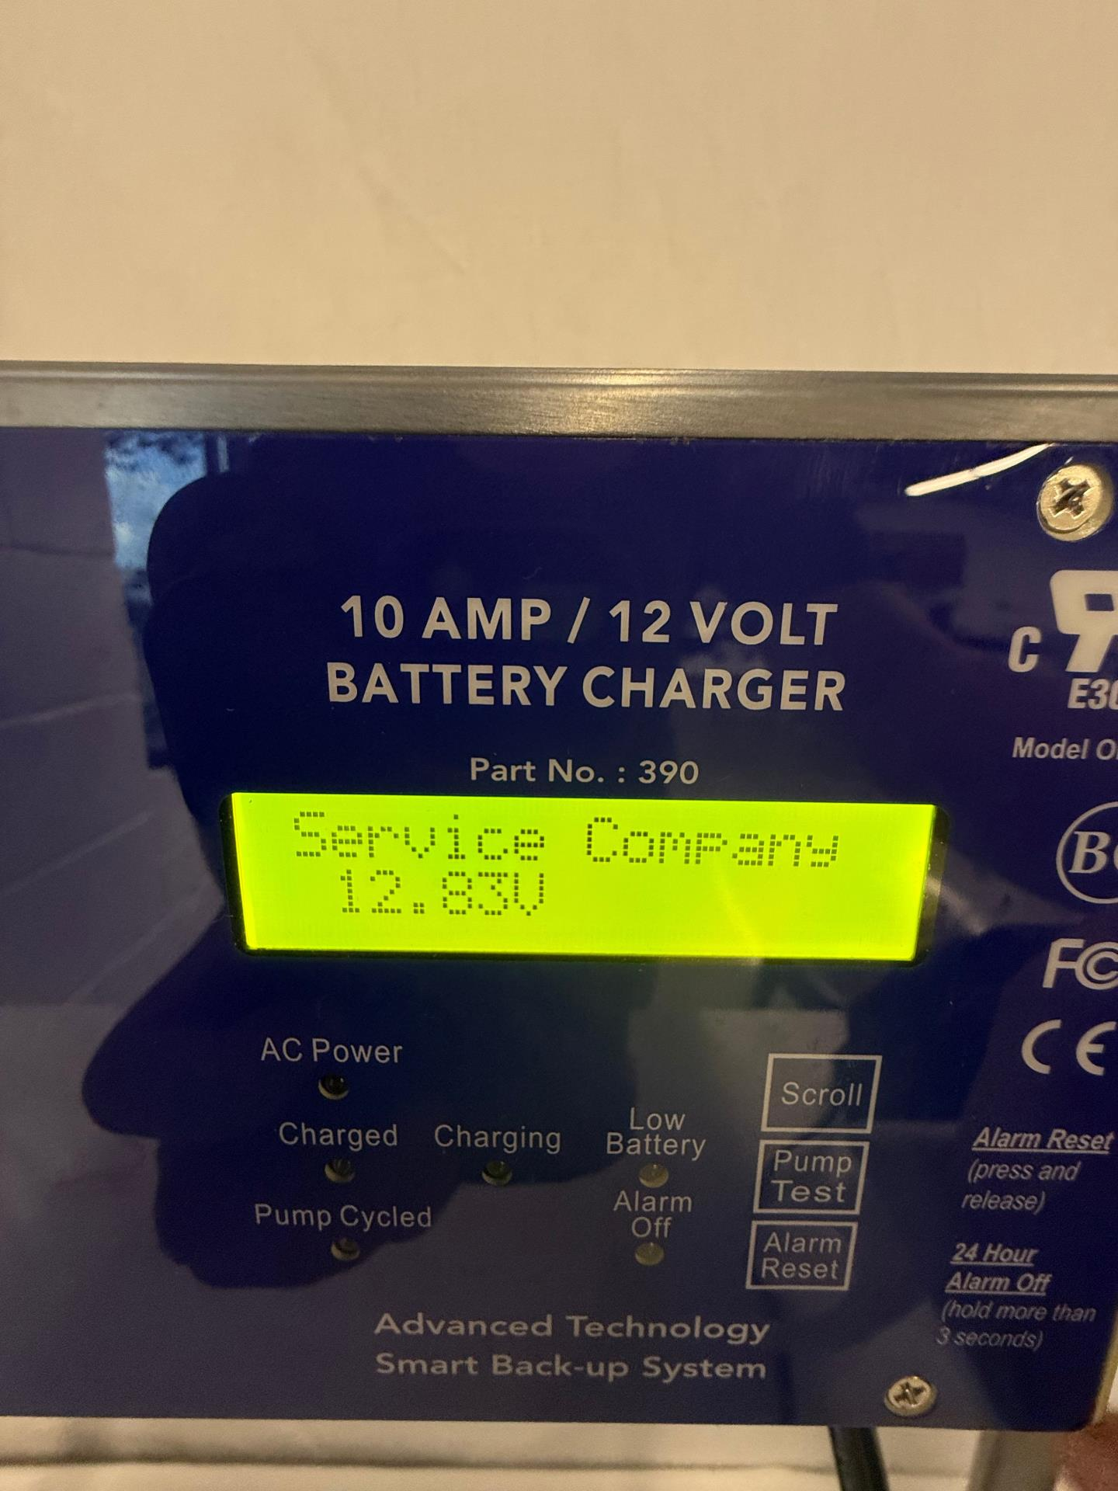
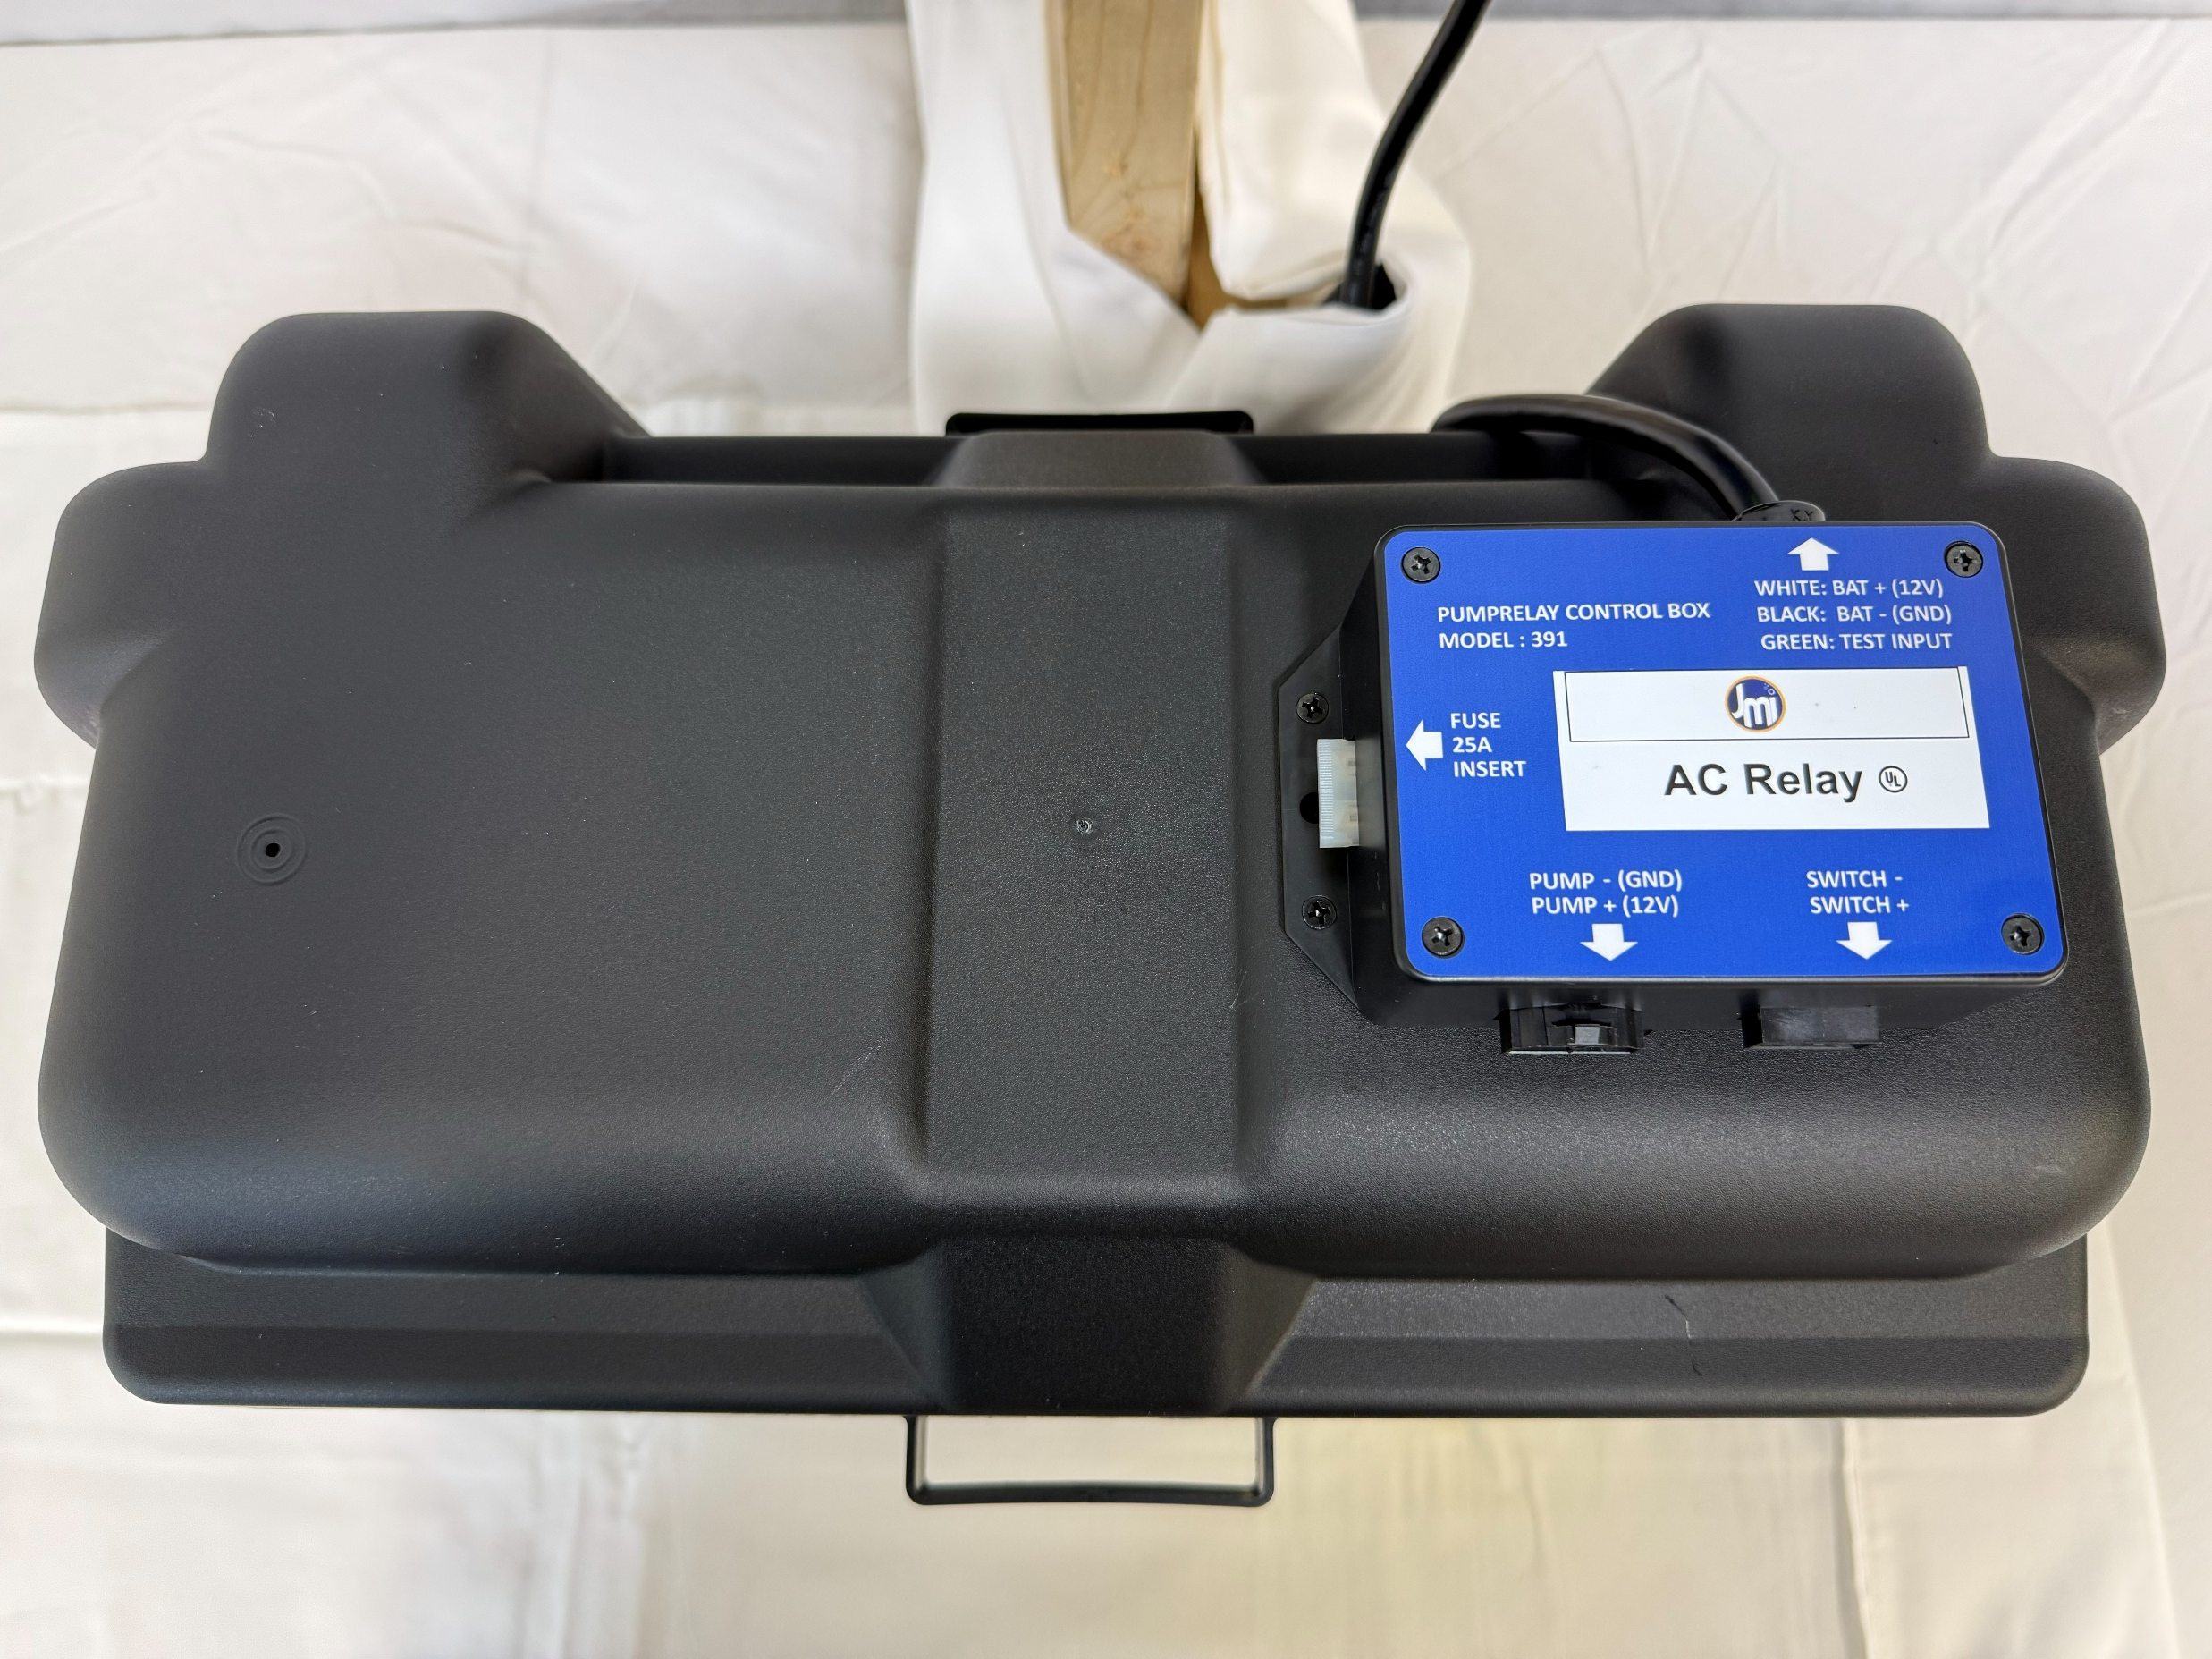
Service Company & Phone number will flash when 'Alarm Reset' is pressed.
Close BATTERY BOX with wiring harness inside. Cord to RELAY BOX & CONTROL / CHARGER should show below harness, at black cord only.

Slide 13
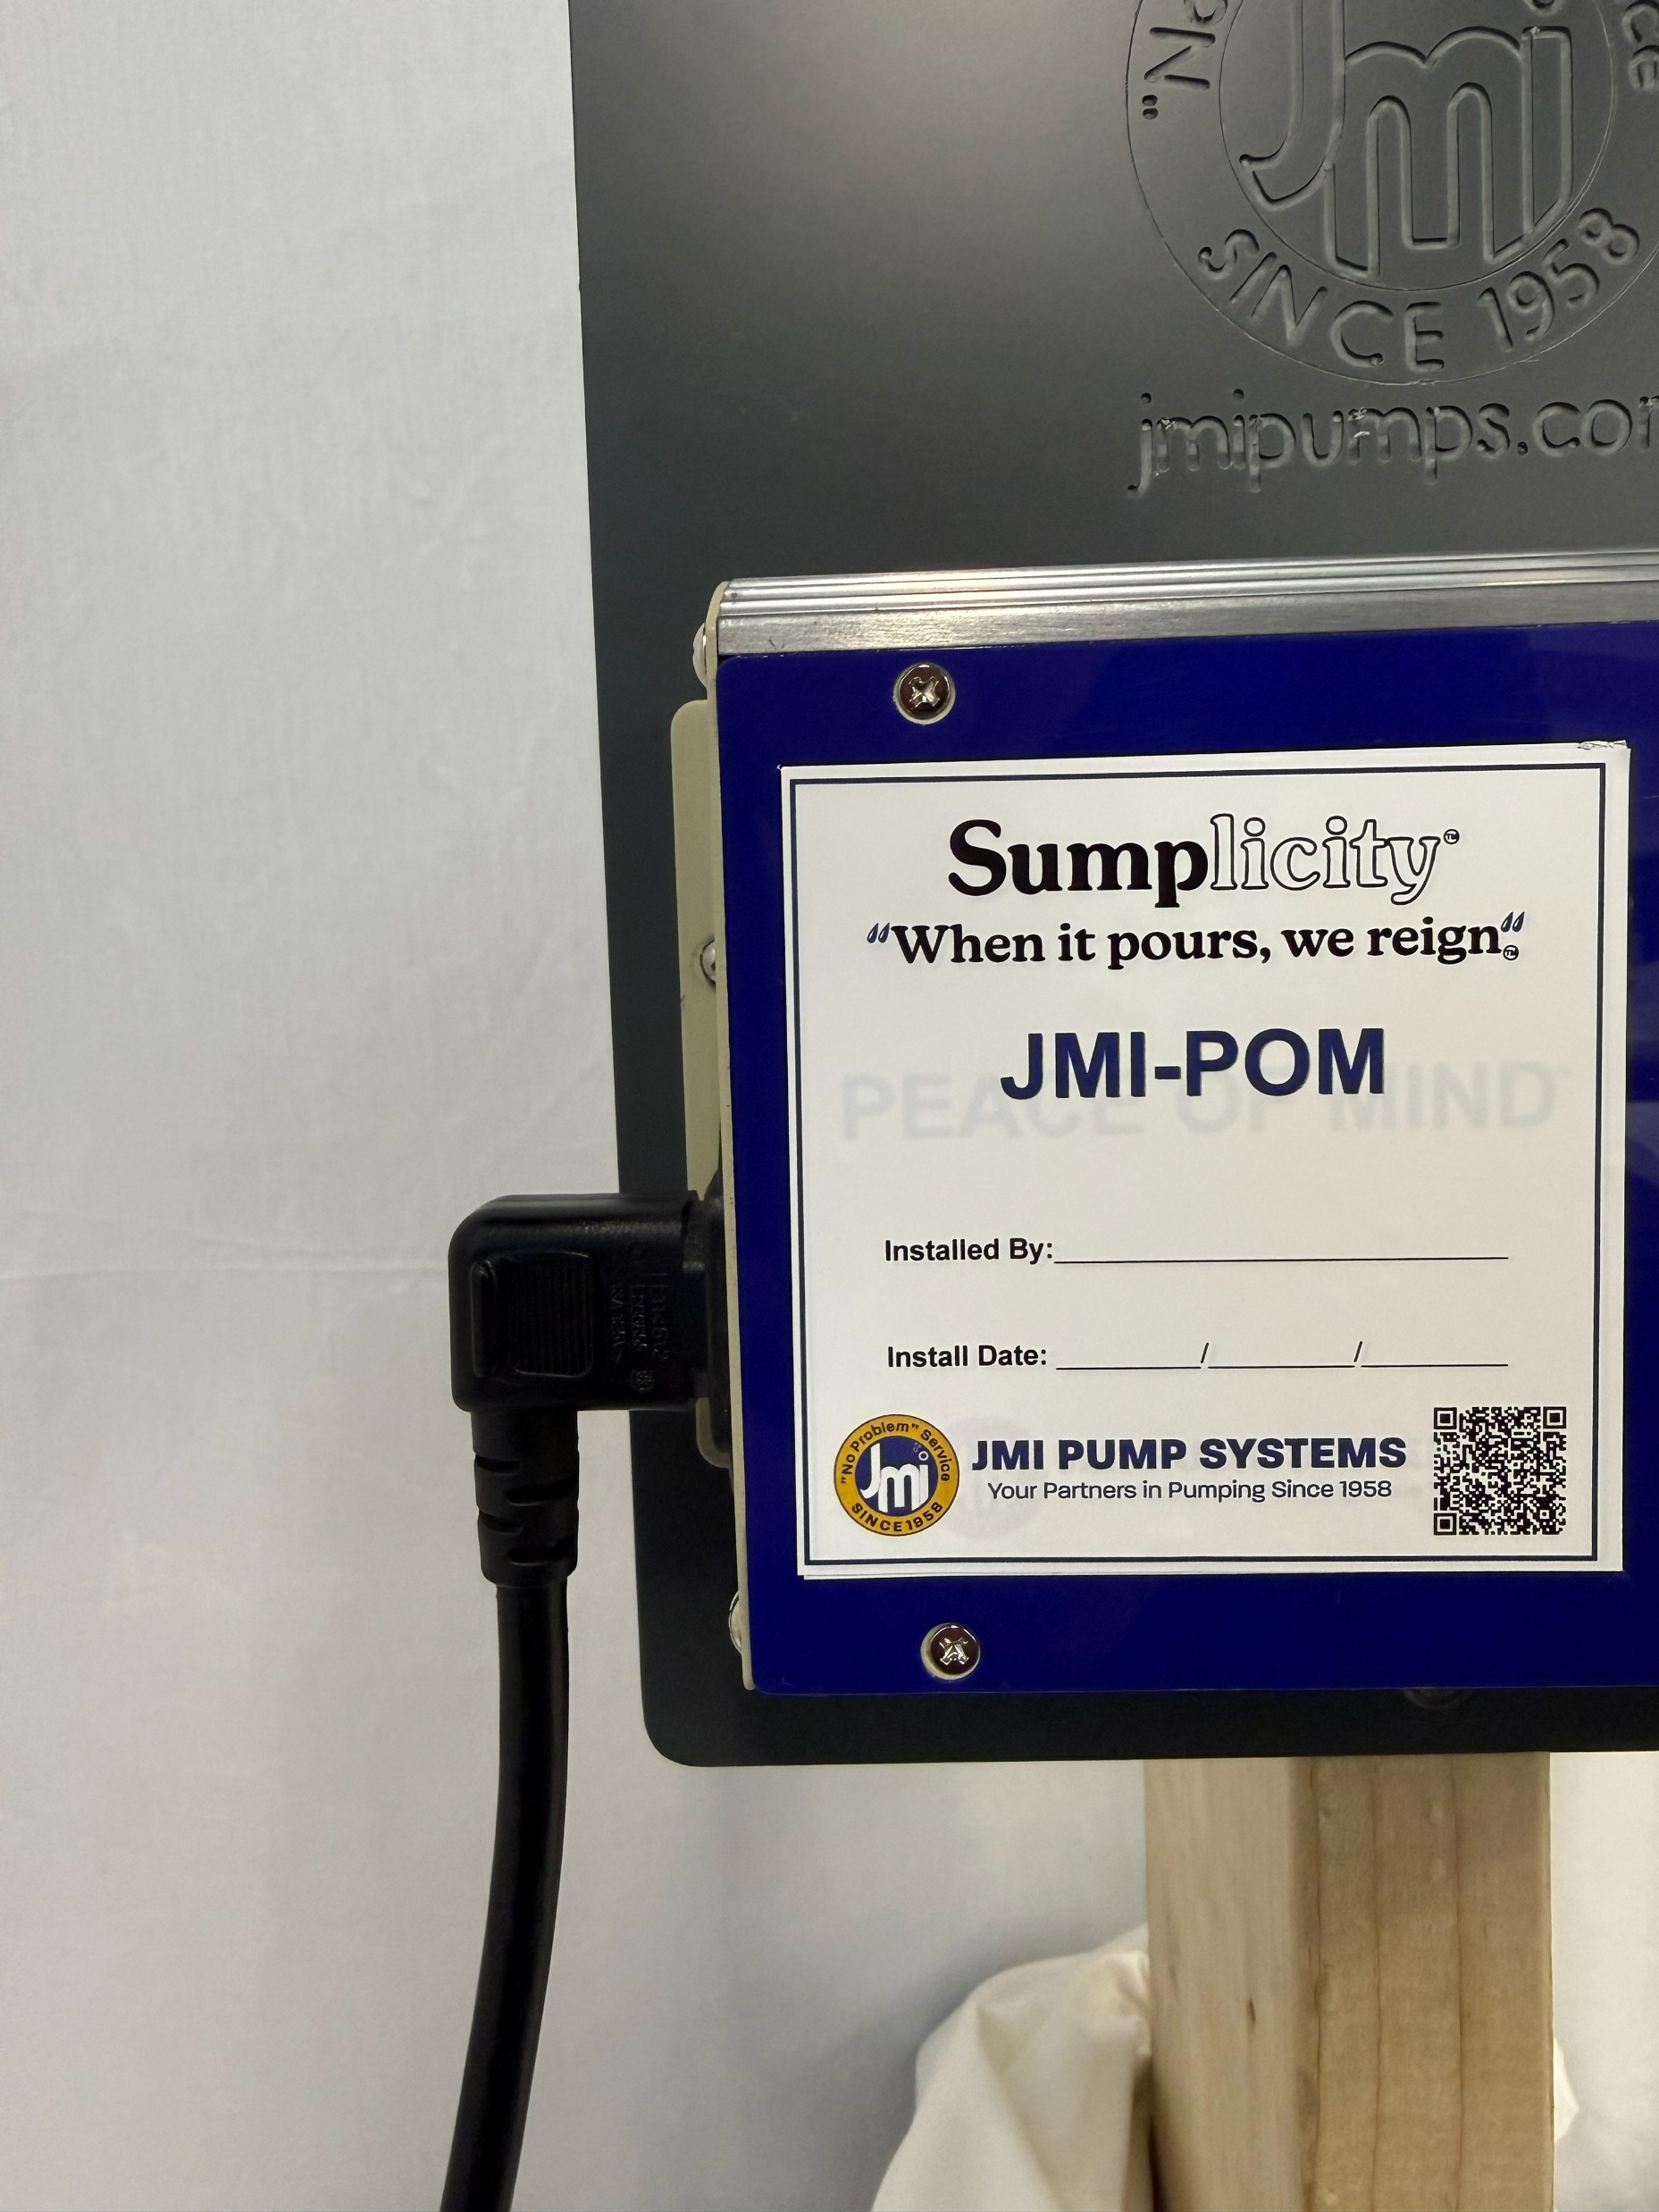
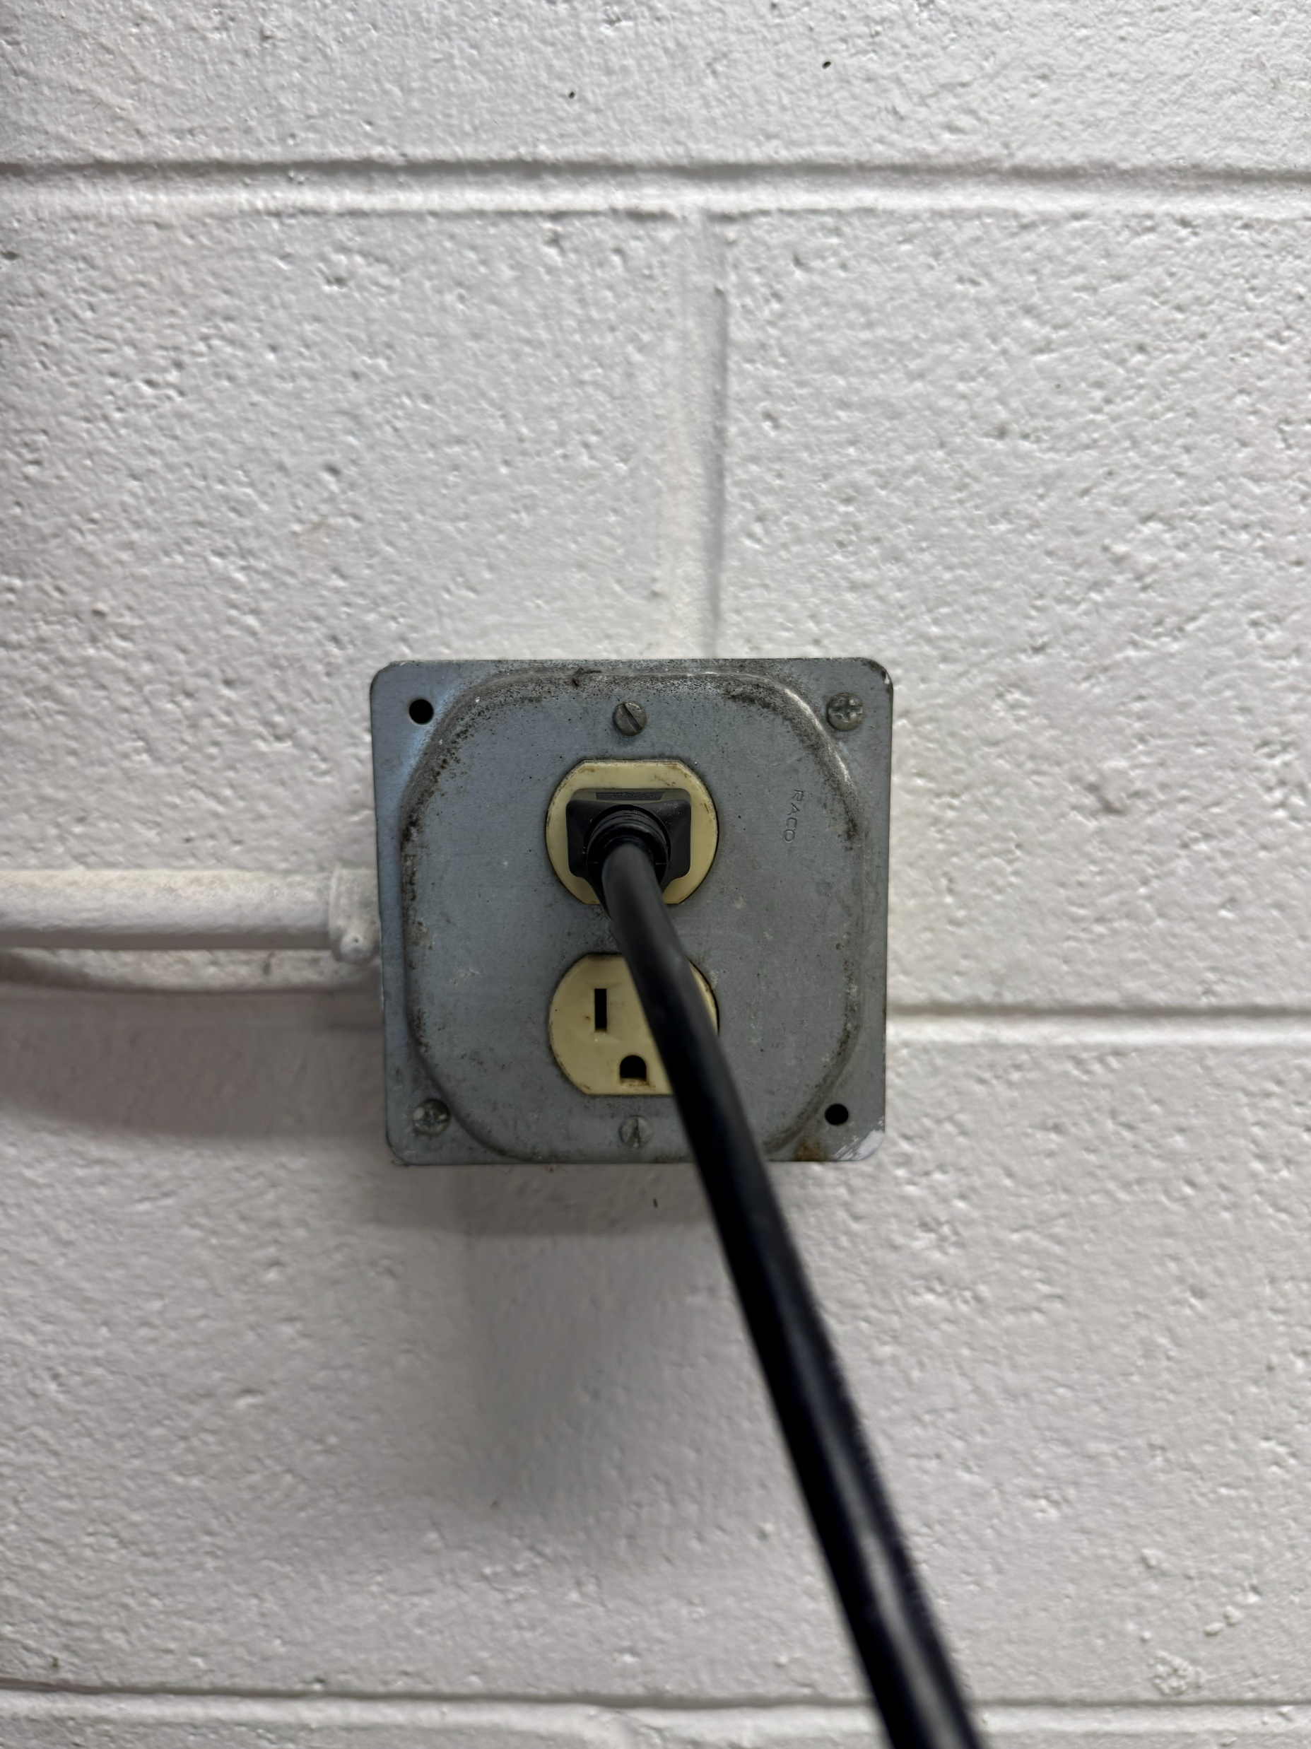
Plug CHARGER CORD into designated input terminal on CONTROL / CHARGER
Plug CHARGER CORD into 115V wall socket; UL recommends 5+ feet off ground

Slide 14
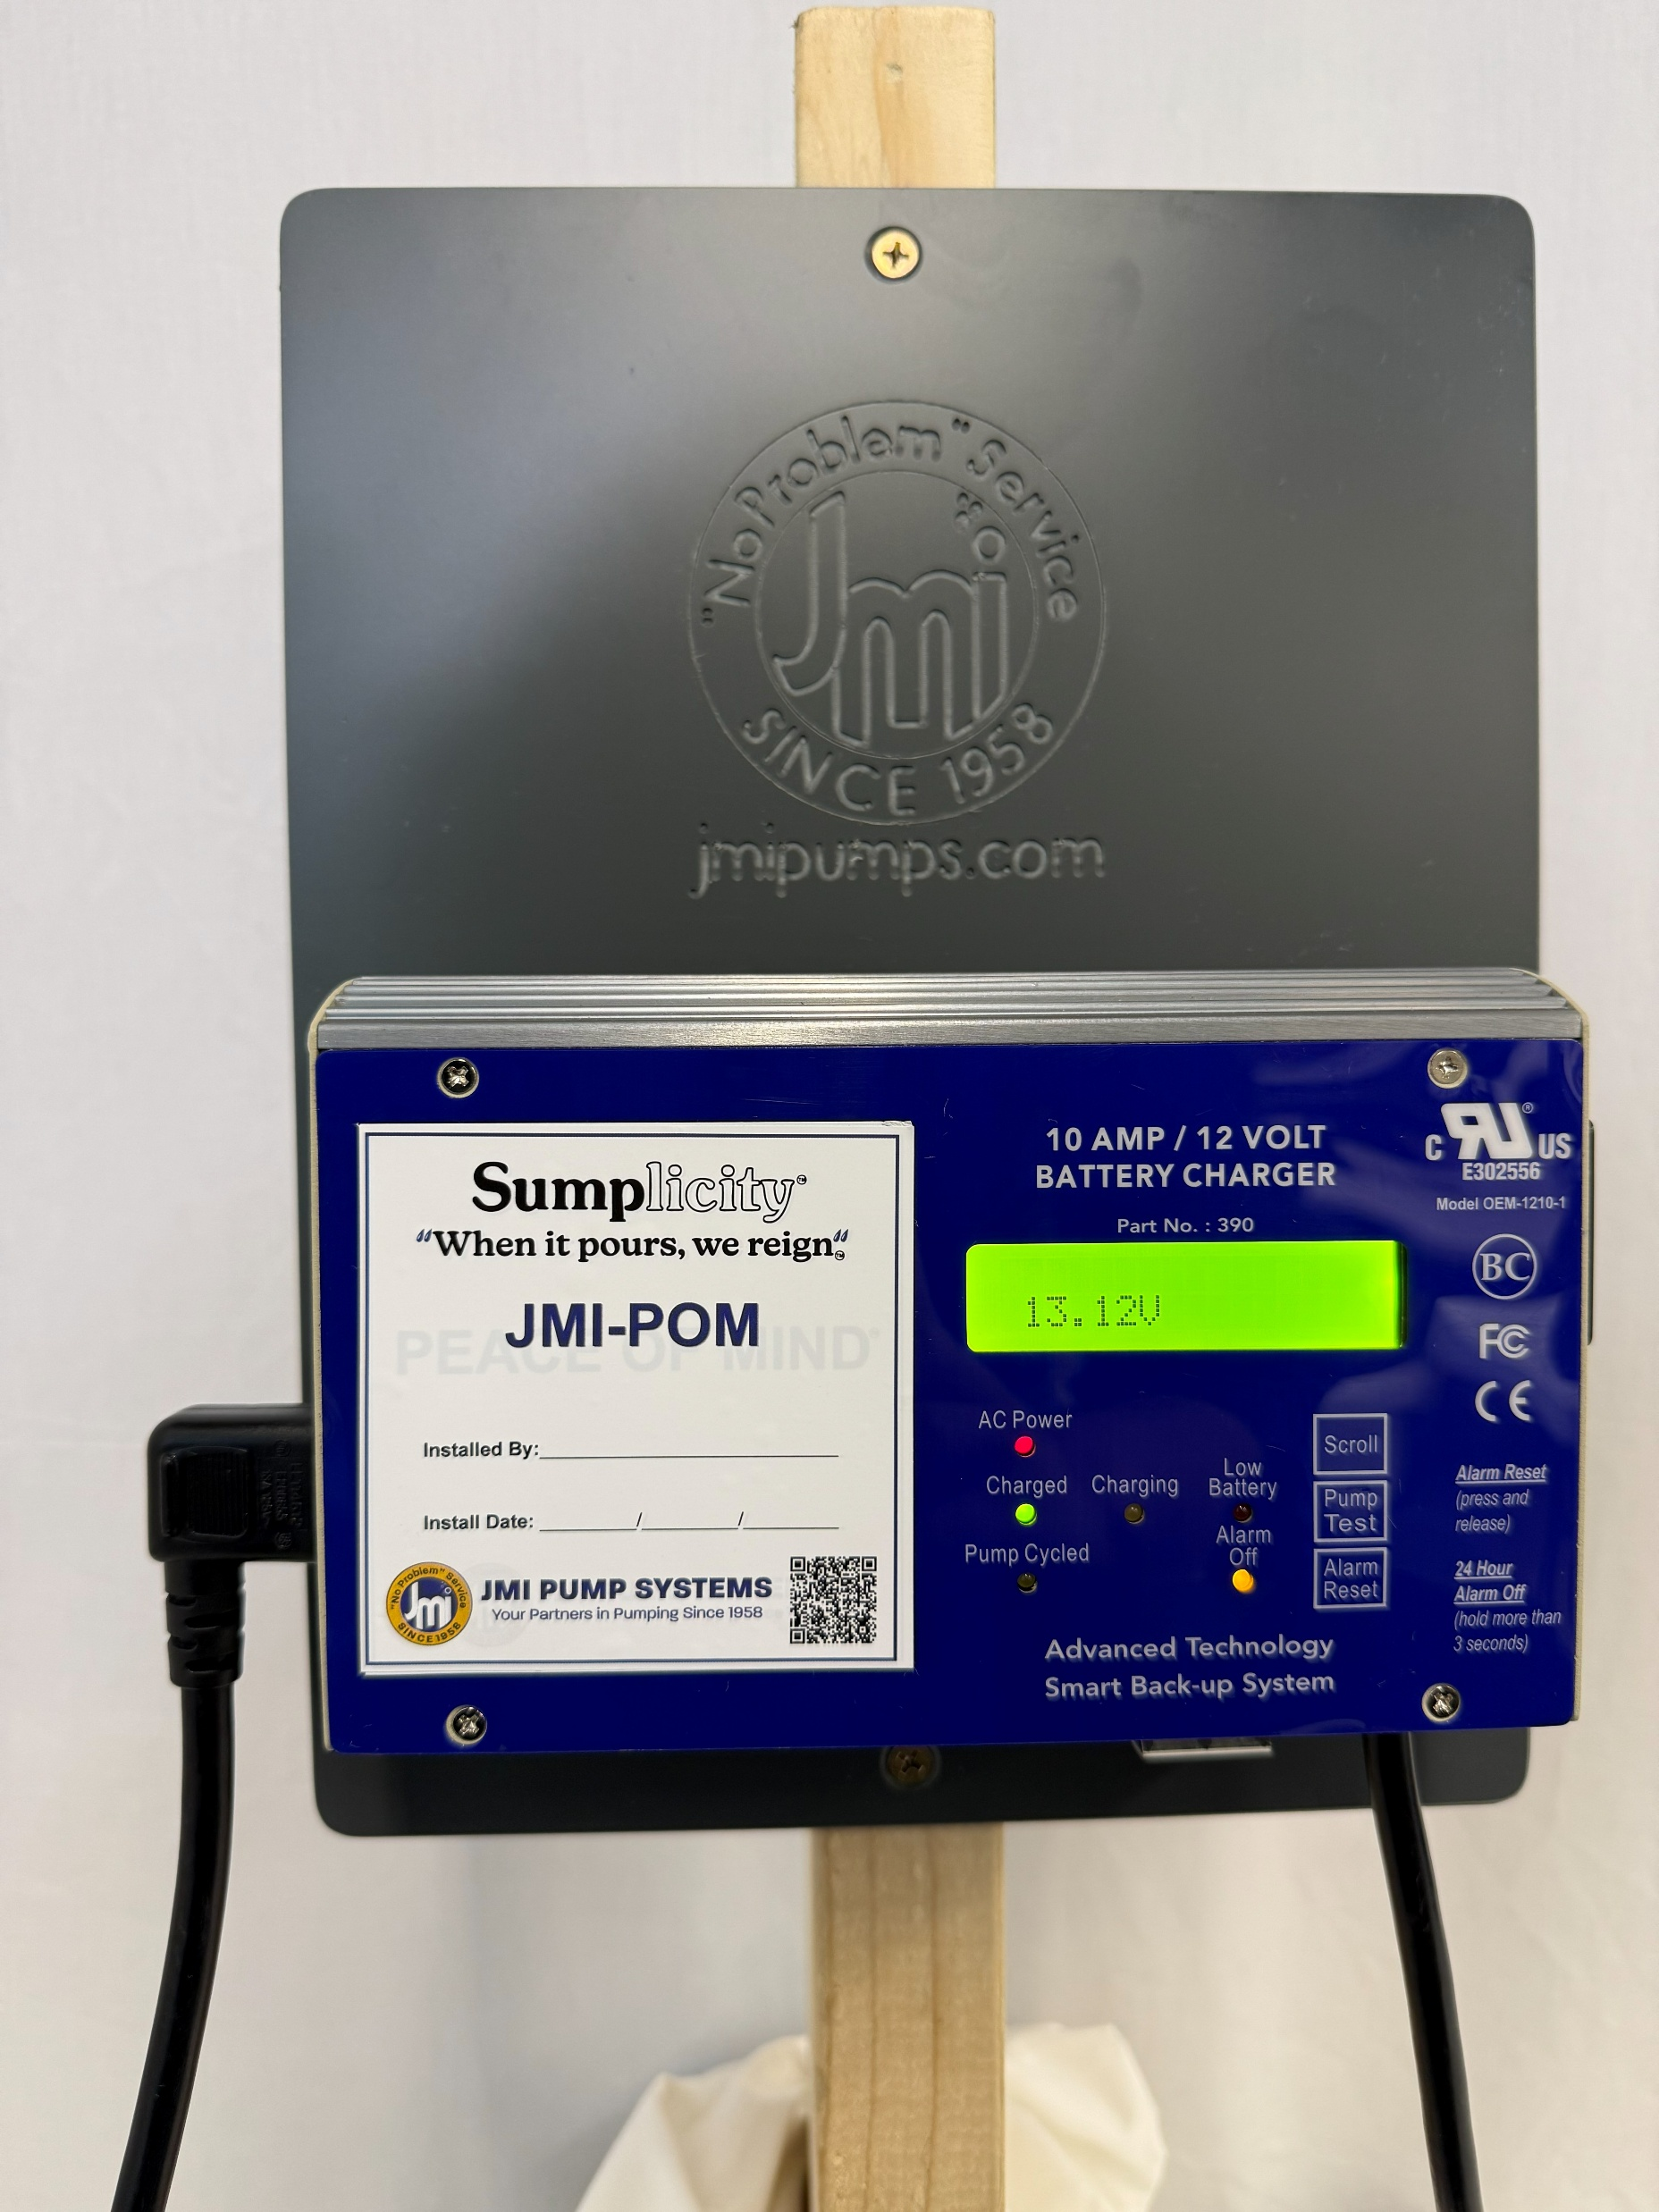
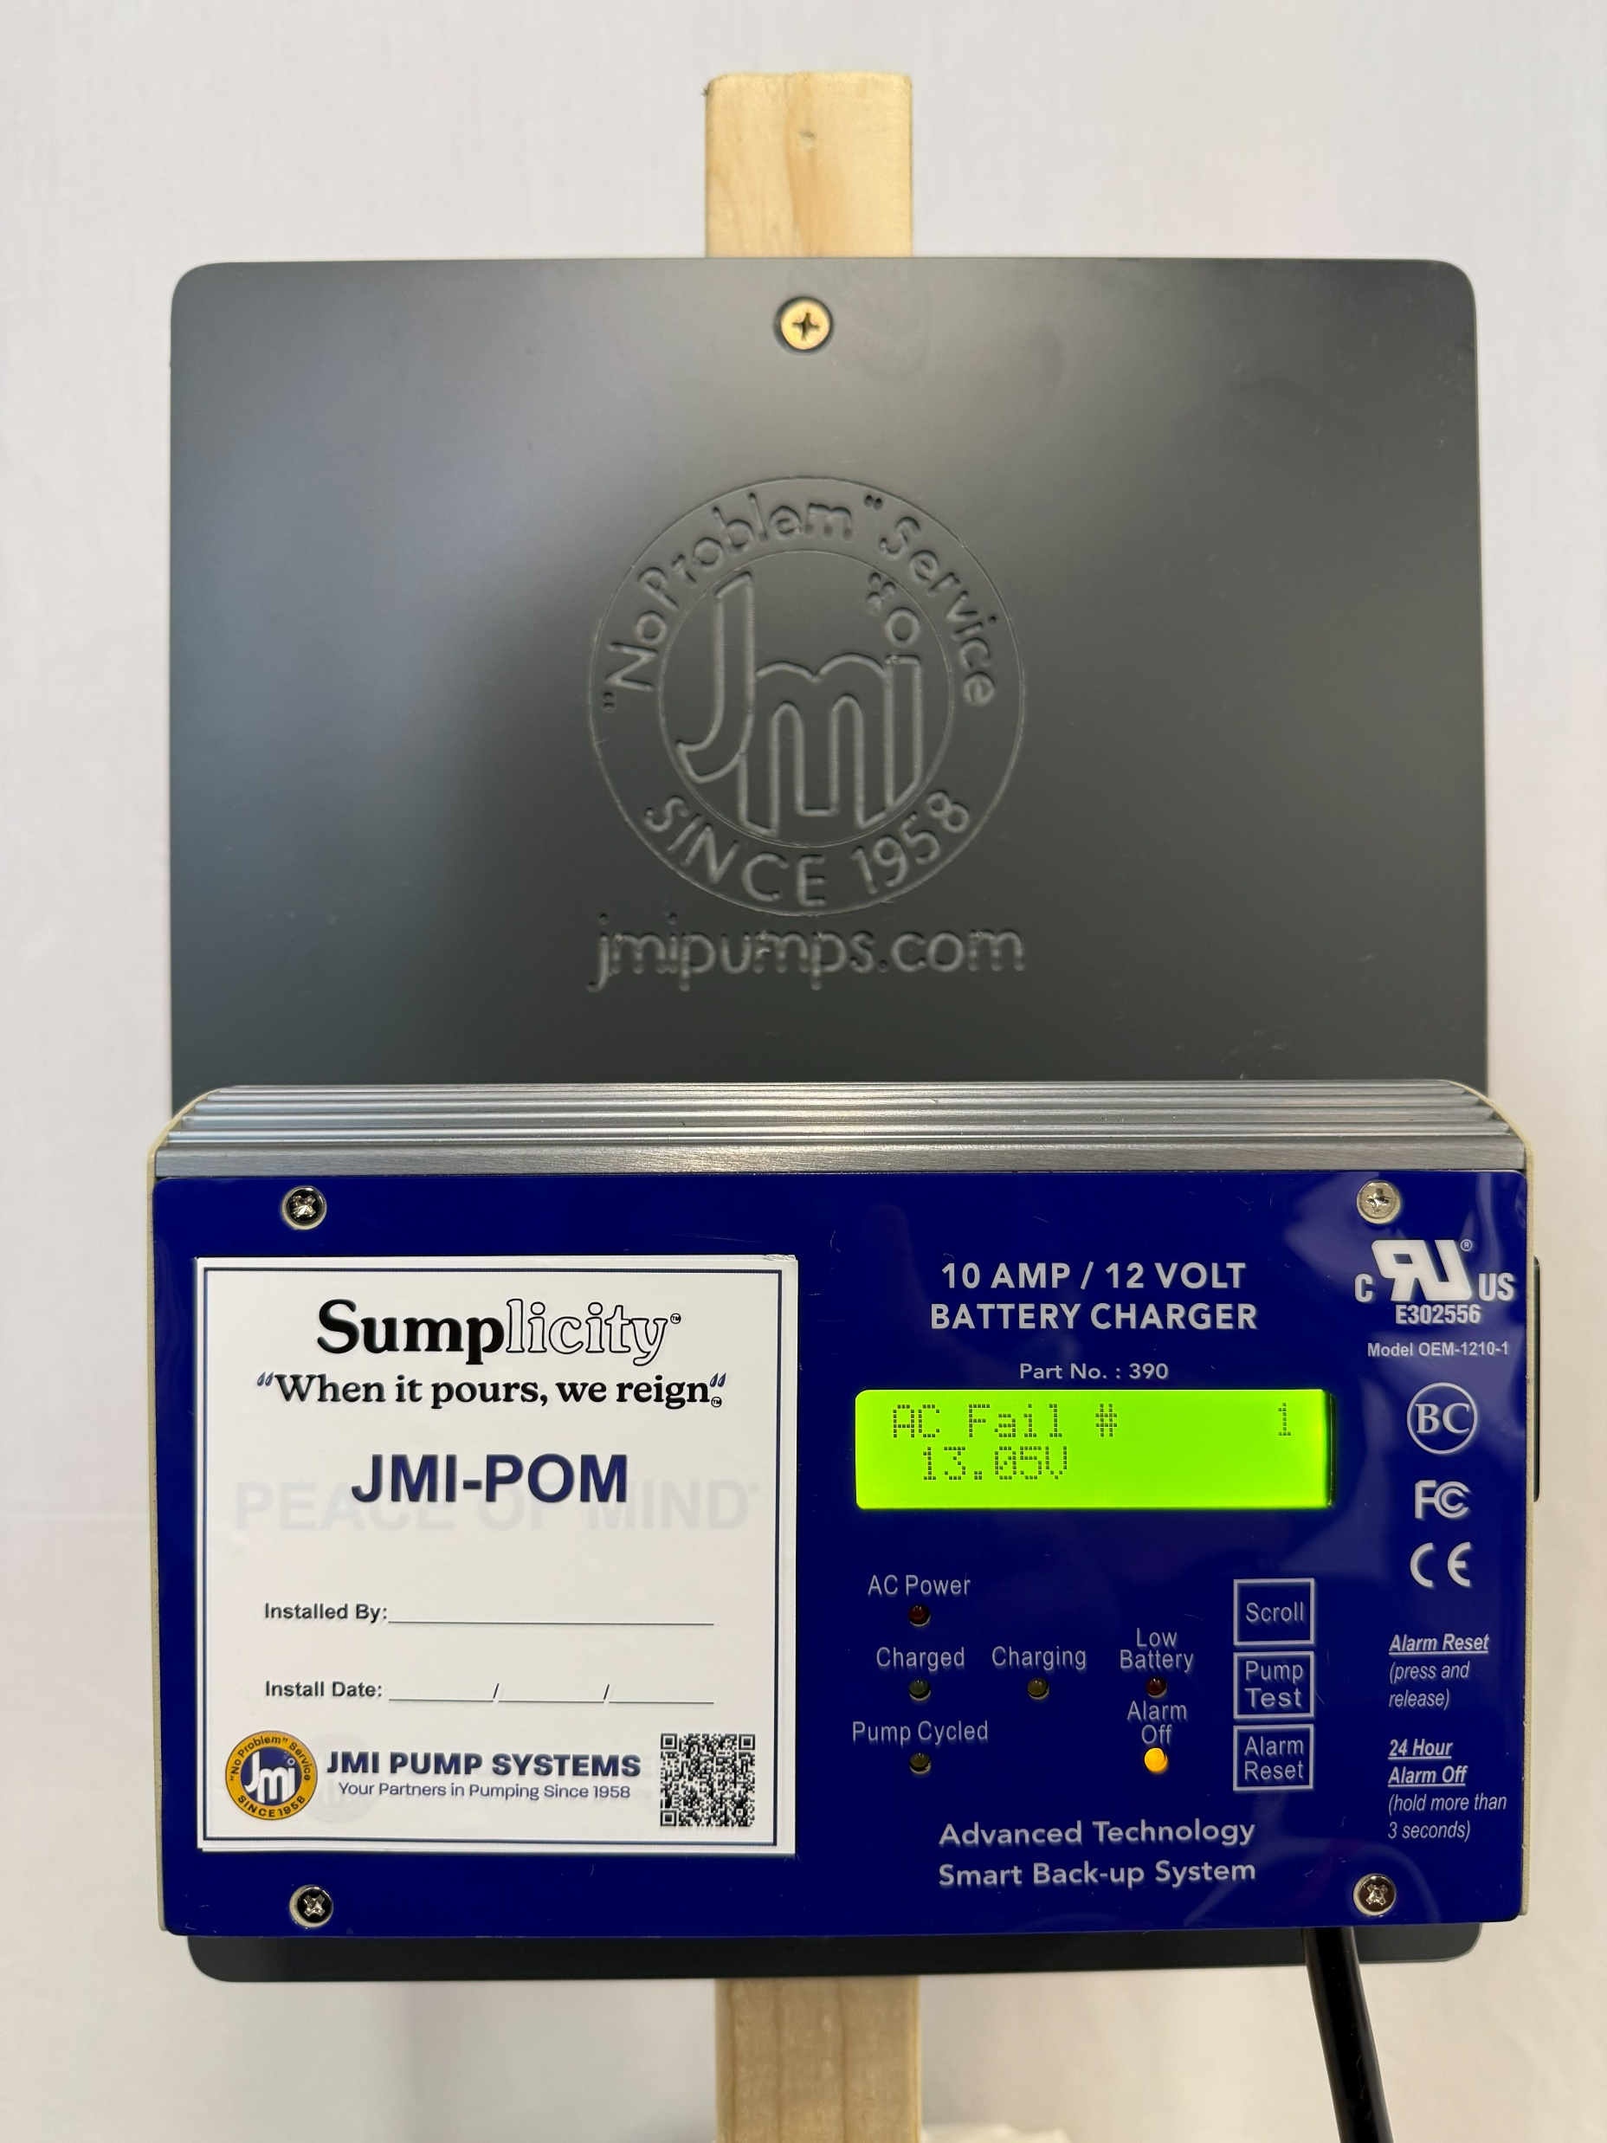
'AC Power' light will turn solid red when unit is charging. Green 'Charged' light will come on. Voltage will increase to ~13.1V with AC Power now supplying the primary power source.
When unit is unplugged from 115V AC Power or power is lost, 'AC Fail #' counter will appear on the screen and alarm will sound (if not silenced).

Slide 15
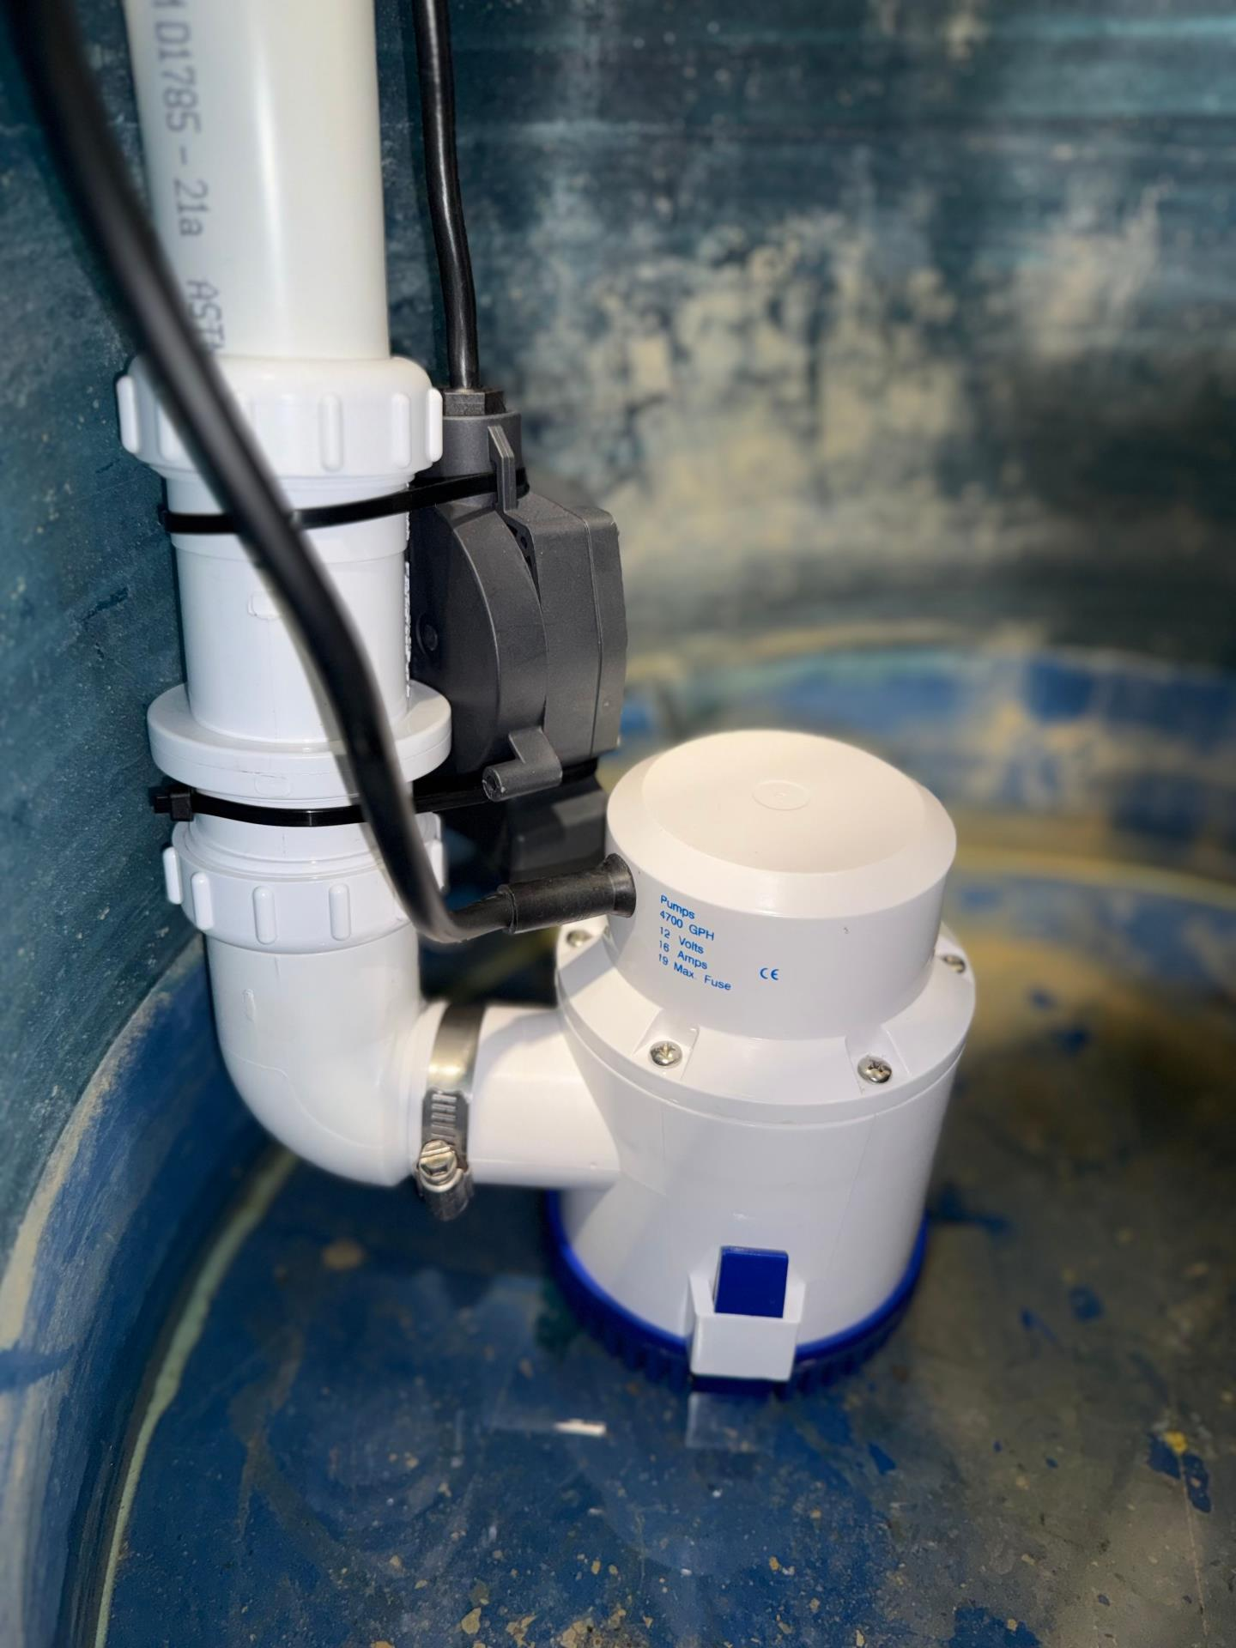
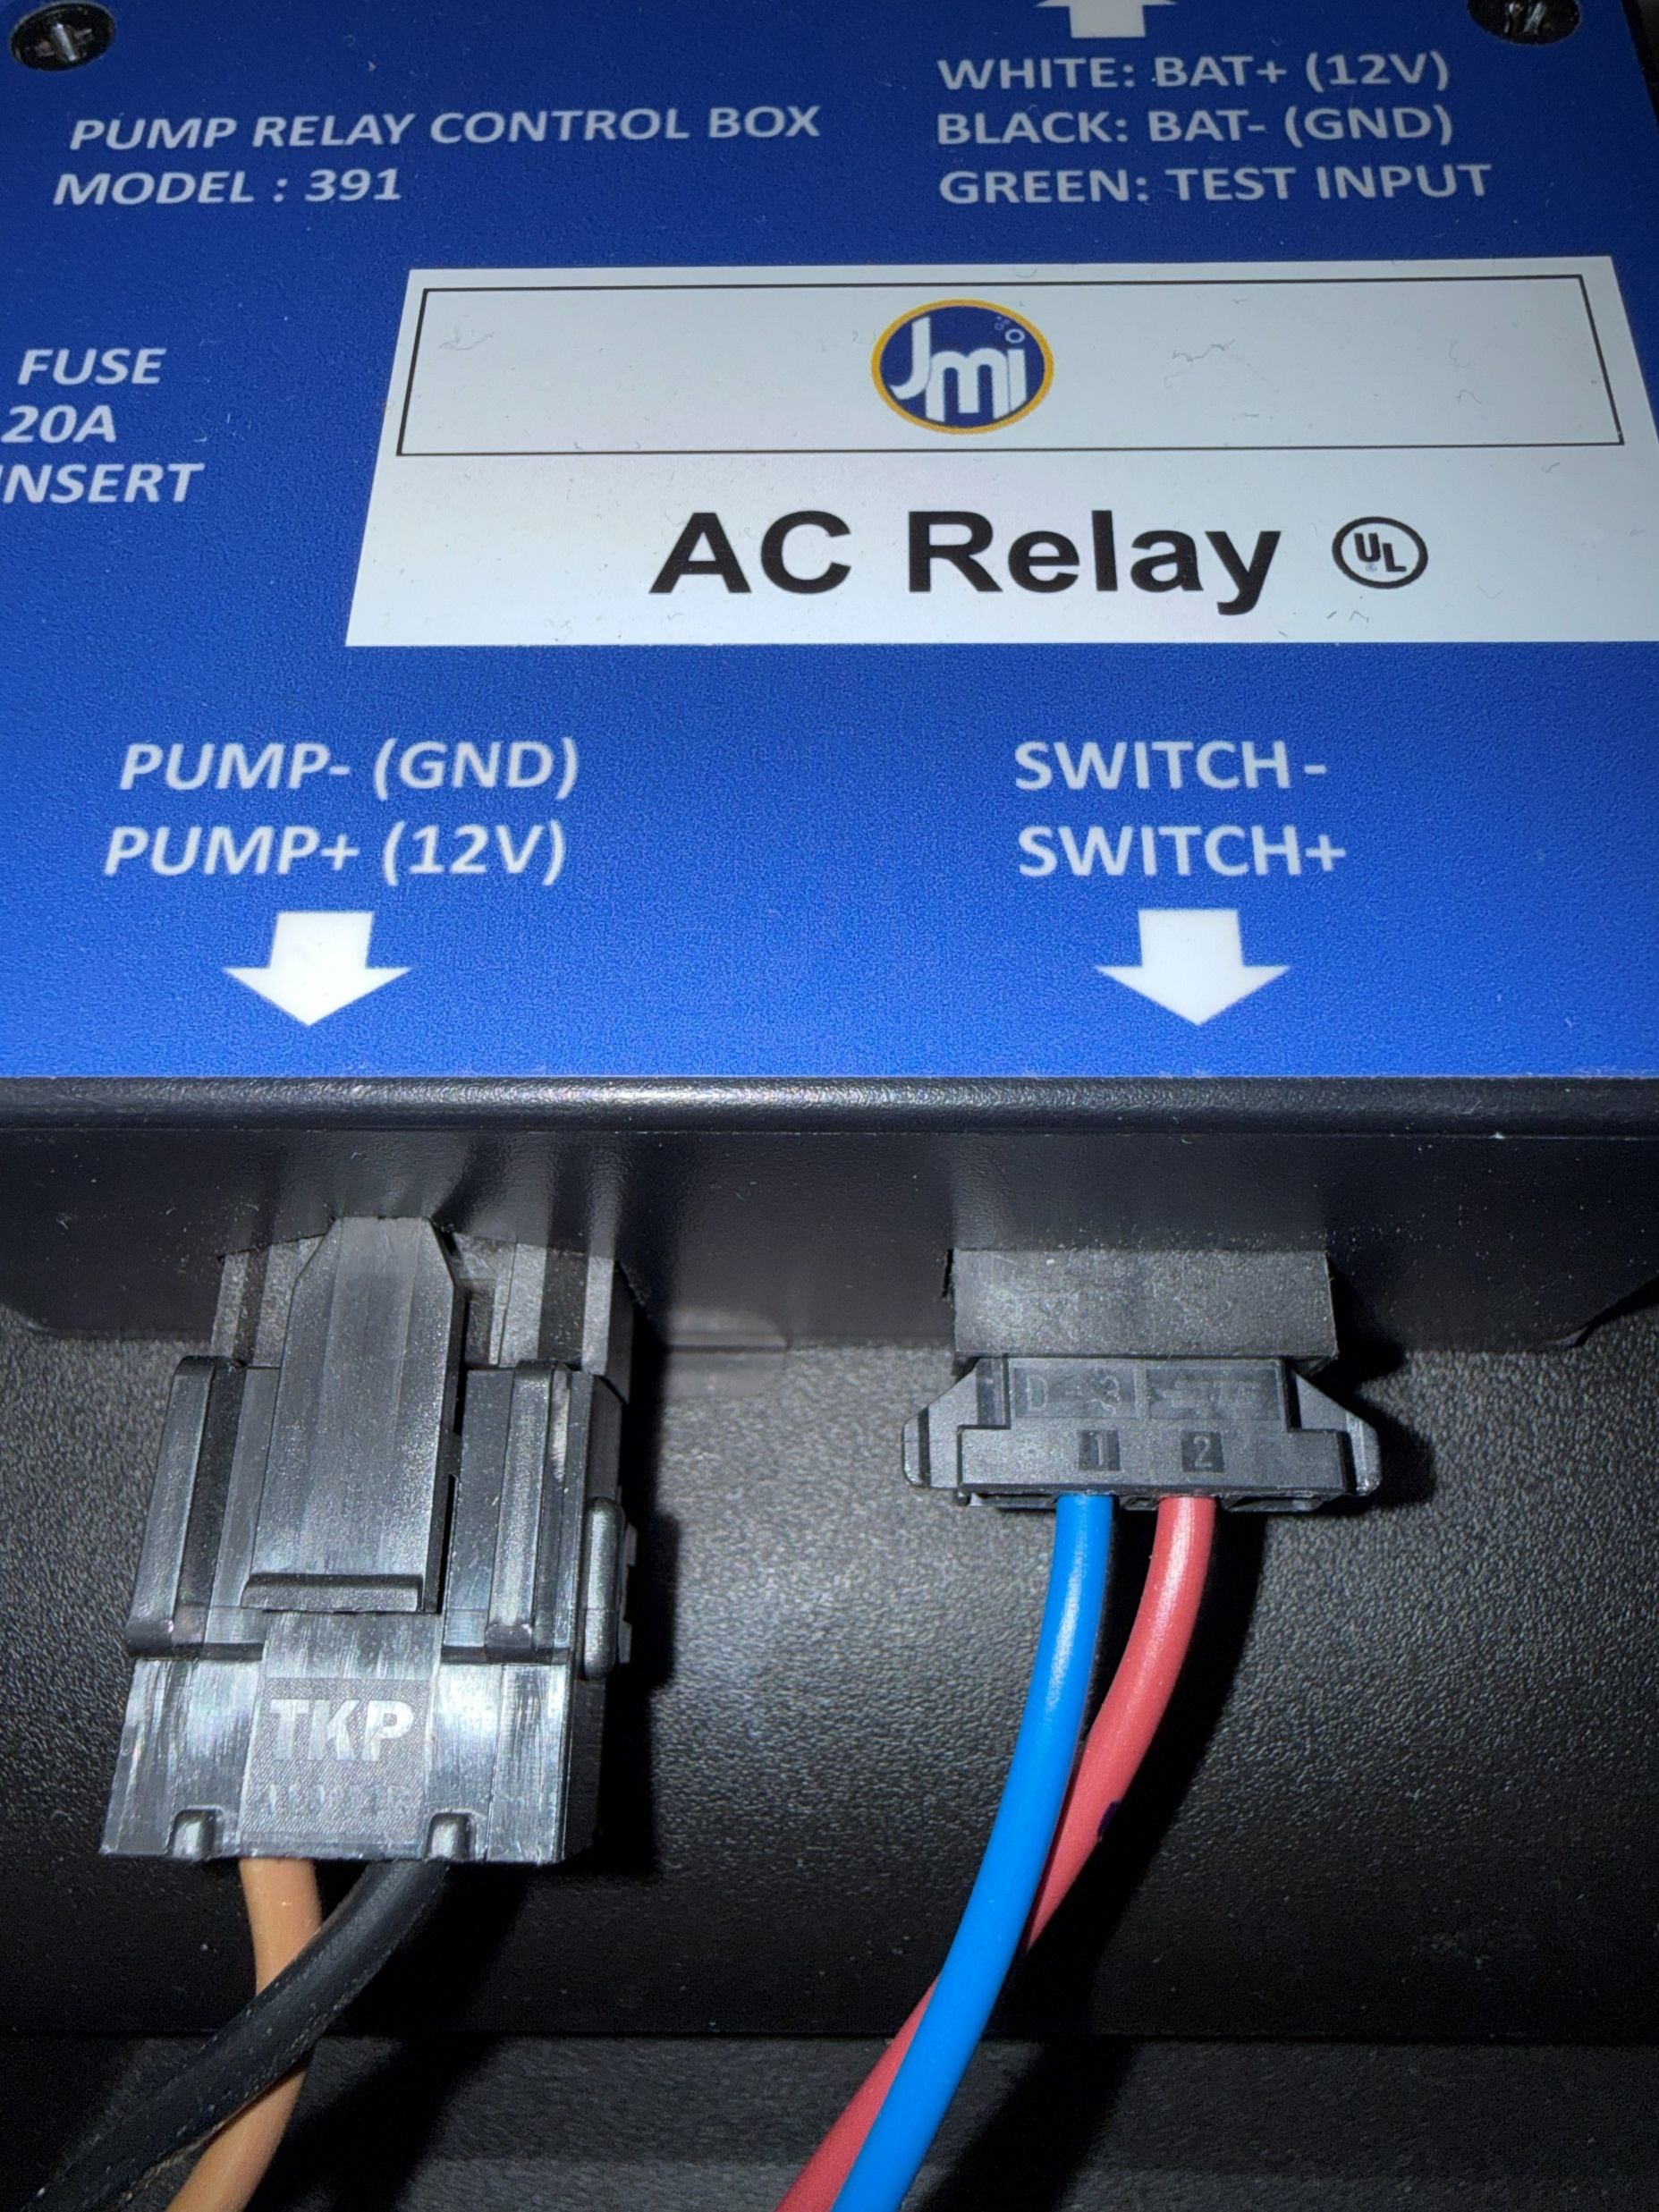
Drop DC PUMP & PRESSURE SWITCH assembly into pit. Ensure pressure switch points away from inlet. Wet test pump after installation.
Plug DC PUMP snap-in connection to 'Pump' terminal and PRESSURE SWITCH snap-in connection to 'Switch' terminal. Hold 'Pump Test' button to test system. 'Scroll' button reveals 'Cycle Count'.

